Slide 1

Respiratory Infections
PAS 523
July 2025
Robert Wood, PharmD, BCCCP, VHA-CM
Adjunct Professor, Milligan College, Physician Assistant Studies Program
Clinical Associate Professor, ETSU College of Pharmacy
Acute Care Clinical Pharmacist Practitioner, James H. Quillen VAMC
Robert.Wood5@va.gov

Slide 2
Objectives = Physician Assistant’s Roles
Identify a patient’s type of pneumonia, the respective most likely pathogens, and appropriate antibiotic options
Formulate appropriate pharmacological treatment regimens and monitoring plans for pneumonias and seasonal flus
Detail discussed medications’ mechanism of action, adverse effects, and drug information pearls

Slide 3
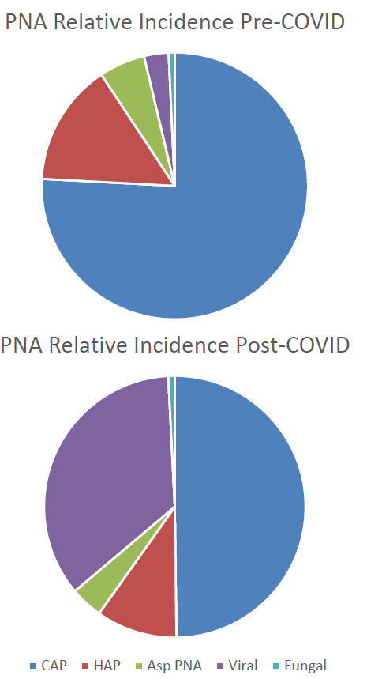
Types of Pneumonia
Community Acquired
Hospital Acquired
  Ventilator Associated
Aspiration
Viral
Fungal

Slide 4
PNA by Organisms
ACCP: Update in Therapeutics 2022.
Notes:
Streptococcus, Mycoplasma, Legionella, and Chlamydia pneumoniae rapid screens exist (urine/blood samples) – if negative, can deescalate away from atypical coverage of fluoroquinolones, macrolides, and tetracyclines…

Slide 5
Community Acquired Pneumonia
IDSA CAP Guidelines 2019.

Slide 6
Community Acquired Pneumonia
IDSA CAP Guidelines 2019.

Slide 7
Hospital Acquired Pneumonia
IDSA HAP Guidelines 2016.
Notes:
Risk factors for mortality include need for ventilatory support due to pneumonia and septic shock.
Indications for MRSA coverage include IV abx during the prior 90 days and treatment in a unit where the prevalence of MRSA among SA isolates is not known or is >20%. Prior detection of MRSA by culture or non-culture screening may also increase the risk for MRSA.
TREAT x 7-10 or 10-14 days

Slide 8
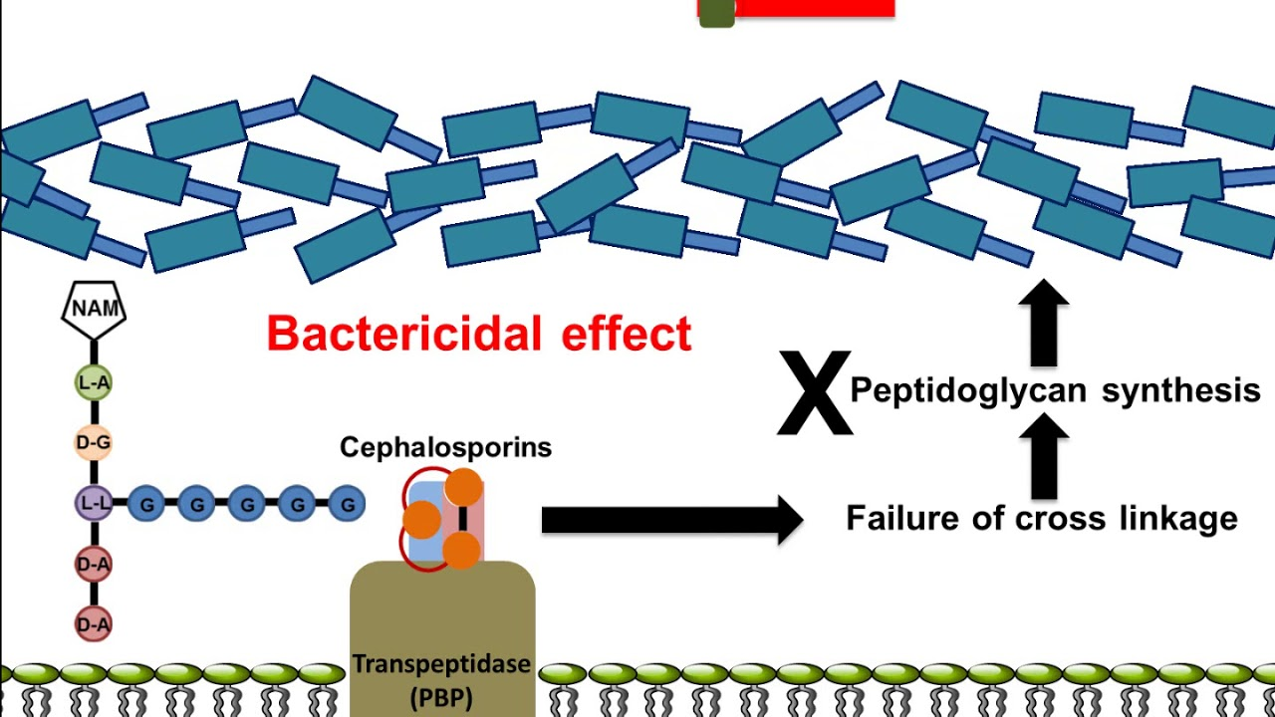
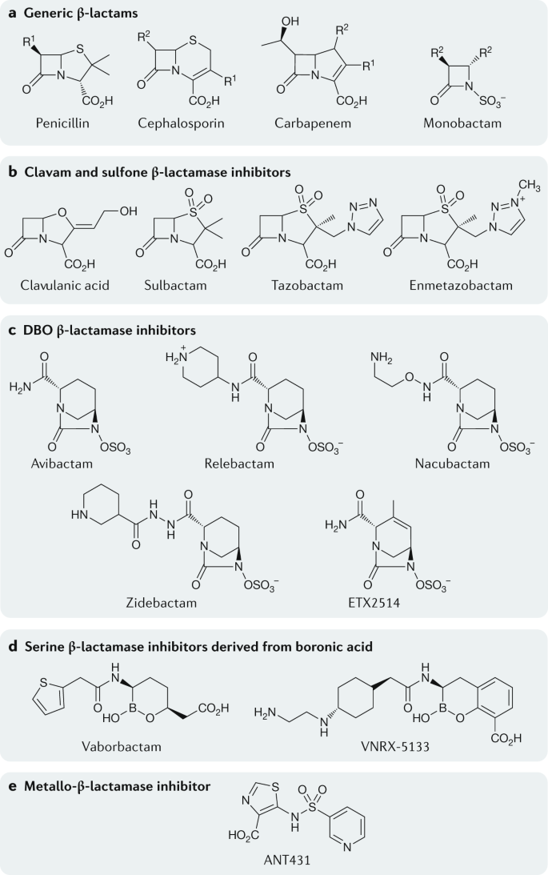
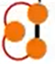
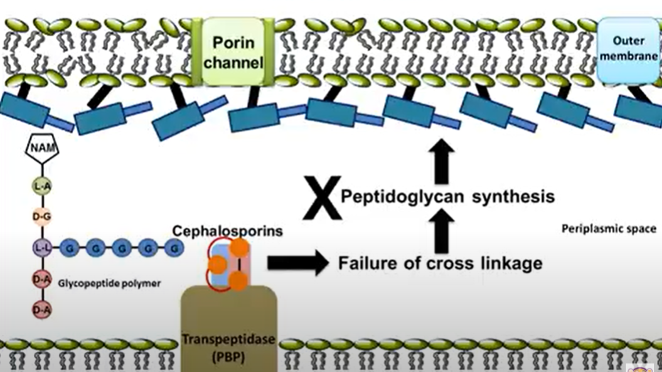
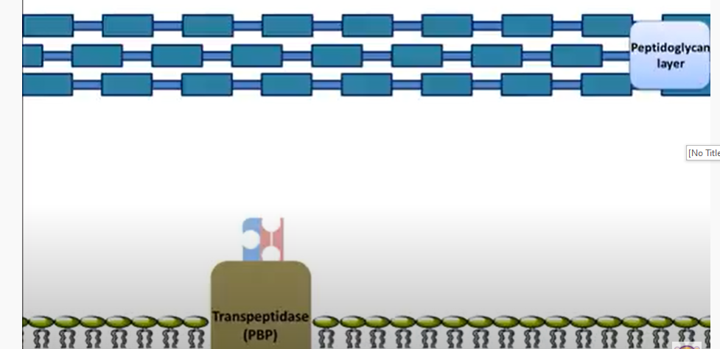
Beta-Lactam Mechanism
Gram + Organism
β-lactam
β-lactams
Gram - Organism
β-lactams
PBP = “Penicillin” Binding Protein

Slide 9
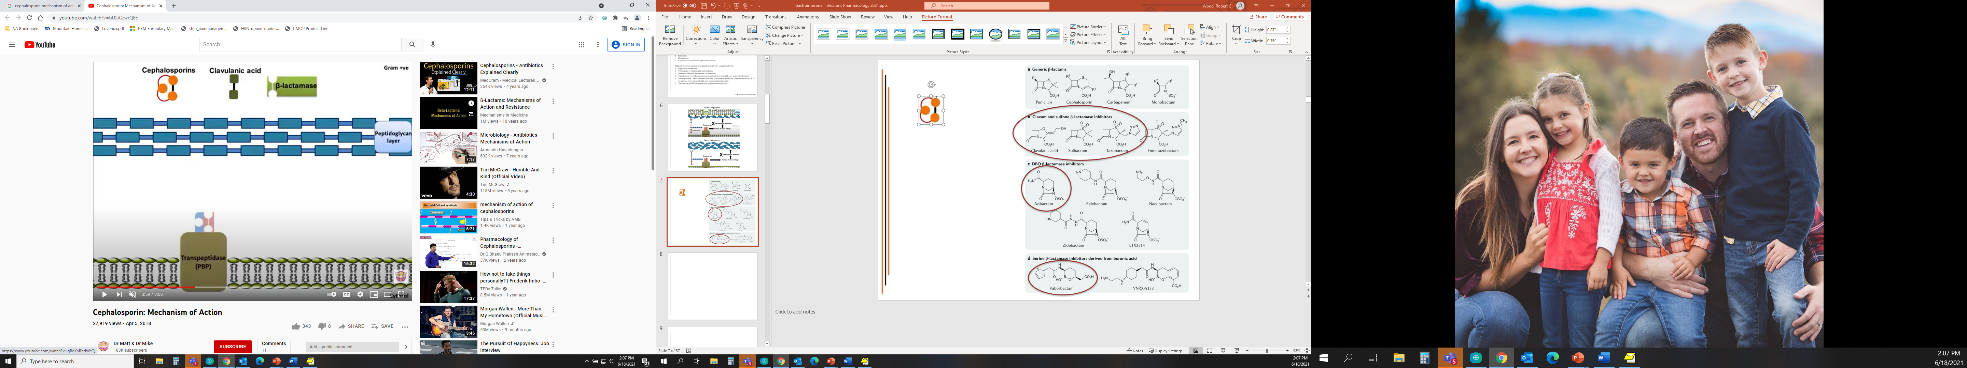

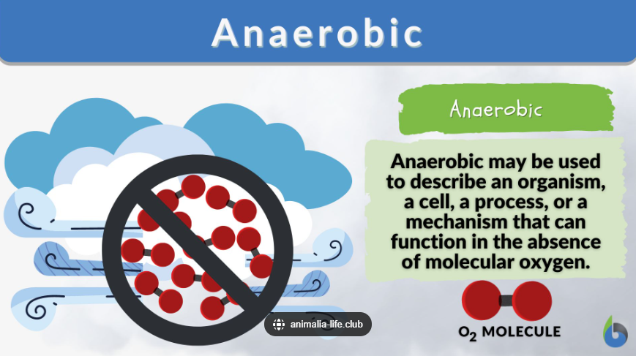
Beta-Lactamase & Inhibitors Mechanism
β-lactam
β-lactamase inhibitor

Slide 10
Beta-Lactam Drug Information Pearls
Dosing Considerations
  Almost all require renal dose adjustments
    Can cause AKI (usually intrinsic – AIN, GN)
    Accumulate w/ impaired clearance → ↑ADRs
Highlight Adverse Effects
  Oral agents → N/V/D (esp w/ β-lactamase inhibitors)
    Take with food to decrease incidence + severity
  Convulsions?
    All abx ↓seizure threshold
      Imipenem/cilastatin > carbapenems > cefepime > other BLs
  Hypersensitivity
    Historically crude, overly associated/reported…but still somewhat common, especially in pediatric patients
      Urticaria, rash (mild → SJS/TEN), SOB, anaphylaxis

Slide 11
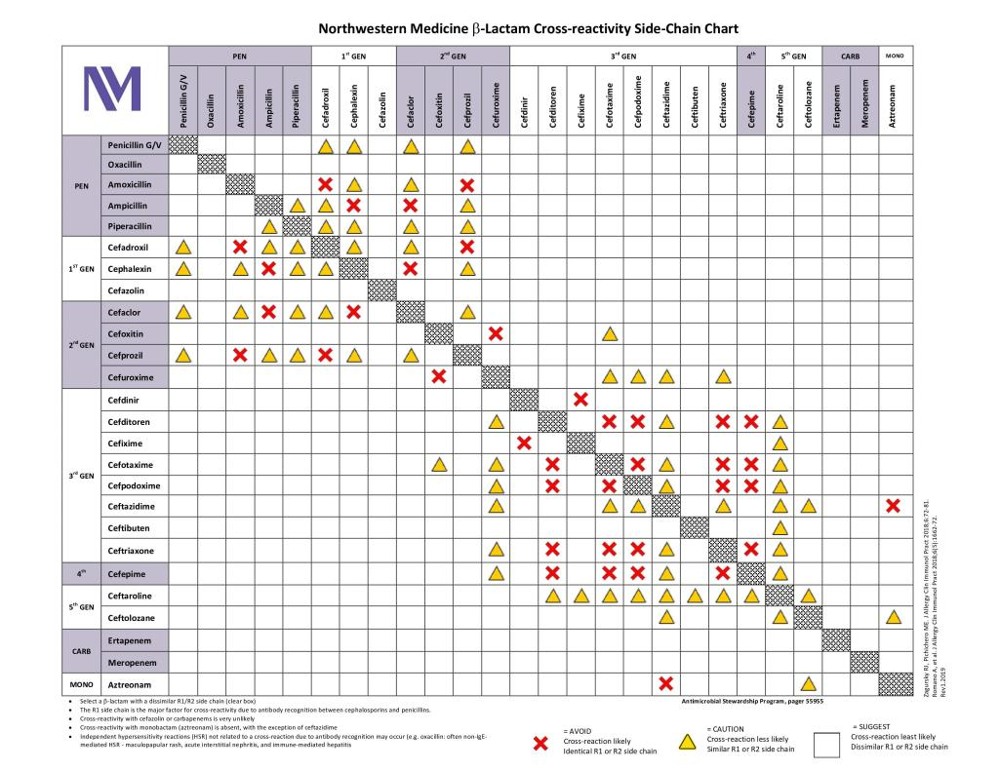
Allergy Cross Reactivity Chart

Slide 12
Guideline Penicillins
Oral
  Amoxicillin (±clavulanate)
Intravenous
  Ampicillin (±sulbactam), piperacillin/tazobactam
    Ampicillin covers Acinetobacter
    Piperacillin/tazobactam covers Pseudomonas

Slide 13
Guideline Cephalosporins
Oral
  Cefpodoxime, cefuroxime
Intravenous
  Ceftriaxone (IM also), cefotaxime
    IM → injection site reaction/pain
      Reconstitute with lidocaine to reduce discomfort
  Cefepime, ceftazidime (±avibactam),
  ceftolozane/tazobactam
    Cover Pseudomonas
    BL# for gram-negative resistance, including ESBL-producers
  Ceftaroline
    Covers MRSA

Slide 14
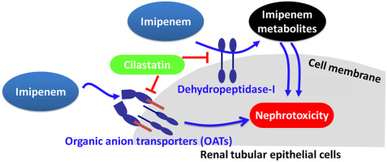
Carbapenems & Monobactam
NO Oral
Intravenous Carbapenems
  Imipenem/cilastatin
  Meropenem (+/- vaborbactam)
    BL# for gram-negative resistance, including CRE infection
  Ertapenem
    Least broad coverage
      No Pseudomonas, Enterococcus, Acinetobacter sp.
Intravenous Monobactam
  Aztreonam
    Gram negative coverage only!
      Includes Pseudomonas
    Inhaled formulation → Bronchospasm ADR
    Least hypersensitivity of all β-lactams

Slide 15
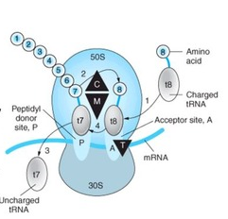
Macrolide & Tetracycline Mechanism
M = Macrolide
T = Tetracycline
Notes:
C = clindamycin, M = macrolides, T = tetracyclines

Slide 16
Guideline Macrolides
Azithromycin (IV/PO), Clarithromycin (PO only)
  Gram positive and atypical coverage only!
Dosing Considerations
  Azithromycin bioavailability ~100% (dosing 1:1)
  Azithromycin outpatient “packs”
    500mg D1 → 250mg D2-5 (Zpak) vs 500mg D1-3 (Tripak)
  Azithromycin inpatient dosing higher (i.e. 500mg daily) and longer duration (i.e 5-7 days) d/t community resistance and treatment failures
Highlight Adverse Effects
  Cardiovascular adversities (ex. QTc ↑)
  Clarithromycin has significant drug interaction potential

Slide 17
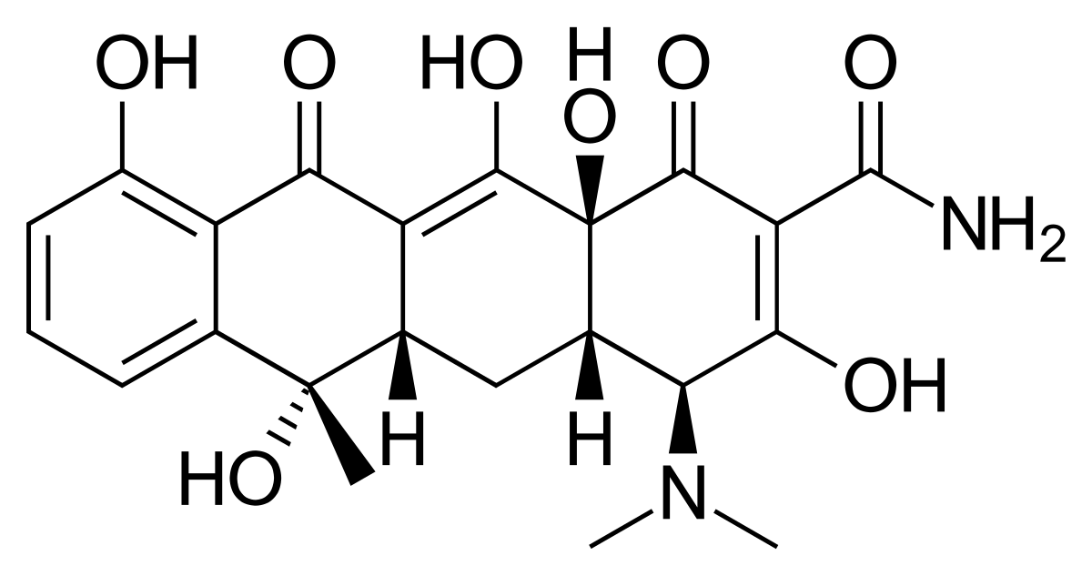
Guideline Tetracyclines
Doxycycline (IV/PO)
  Gram positive and atypical coverage only!
    Includes CA-MRSA
Dosing Considerations
  Bioavailability ~100% (dosing 1:1)
  Separate from “cations” (antacids, dairy products, supplements)
    Chelation inhibited absorption
      Separate by 1-2 hours before & after
Highlight Adverse Effects
  N/V/D
    Take with food (just not milk) to decrease incidence + severity
  Photosensitivity (drug-light skin reaction → ↑ sunburn/rash risk)
  Discolored dentition
    Only use in pts > 8 YOA to reduce risk of permanently staining

Slide 18
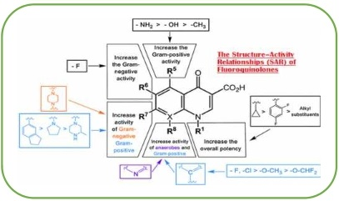
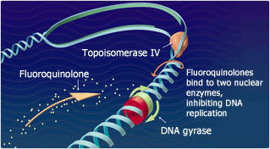
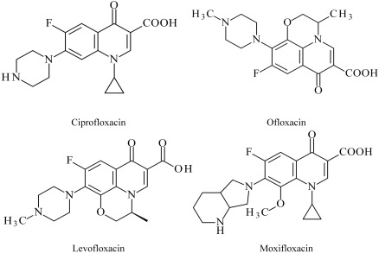
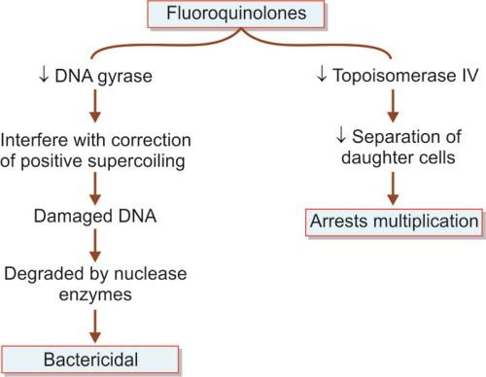
Fluoroquinolone Mechanism

Slide 19

Guideline Fluroquinolones
Levofloxacin, Moxifloxacin (IV/PO)
  Only PO options that cover Pseudomonas
    ~70% susceptibility/30% resistance
  “Moxi”floxacin covers anaerobes
Dosing Considerations
  Bioavailability ~ 100% (dosing 1:1)
  Require renal dose adjustments
    Accumulate w/ impaired clearance → ↑ADRs
  Separate from “cations” (antacids, dairy products, supplements)
    Chelation inhibited absorption
      Separate by 1-2 hours before & after
Highlight Adverse Effects
    Altered mental status
    Cardiovascular adversities (ex. QTc ↑)
    Dysglycemia (hyper- and hypo-)
    Drug interactions common
    Photosensitivity (drug-light skin reaction → ↑ sunburn/rash risk)
    Tendinopathy

Slide 20
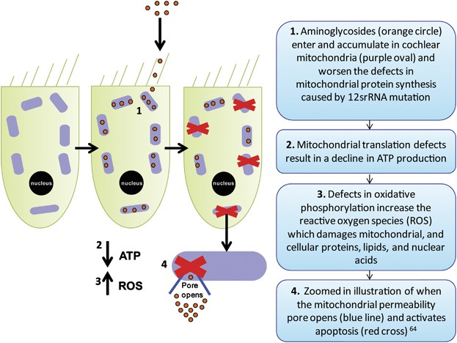
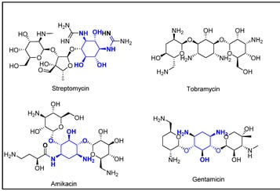
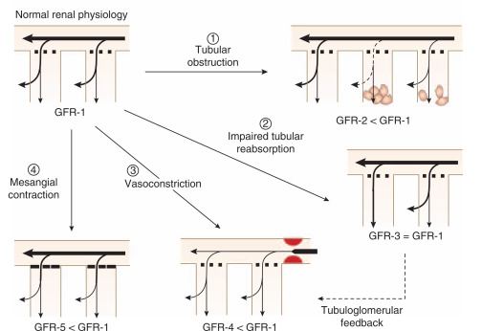
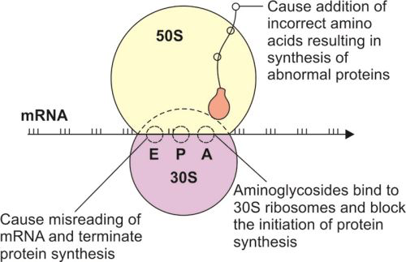
Aminoglycoside Mechanism

Slide 21
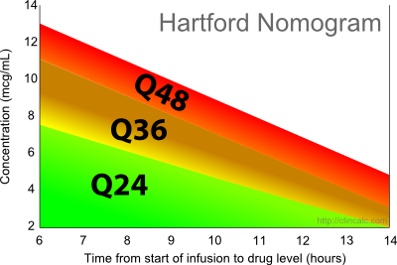
Guideline Aminoglycosides
NO oral
Intravenous
  Amikacin, Gentamicin, Tobramycin
    Gram negative coverage only!
      Includes Pseudomonas
    All require renal dose adjustments
      Can cause AKI (usually intrinsic – ATN)
      Accumulate w/ impaired clearance → ↑ADRs
    Amikacin dosing 3x gentamicin, tobramycin
    Tobramycin inhaled formulation
Highlight Adverse Effects
    High peak levels (usually not drawn, from too high dose)
      Ototoxicity
    High trough levels (>2mcg/ml, >6mcg/ml for amikacin,
    from too high cumulative dosing)
      Nephrotoxicity

Slide 22
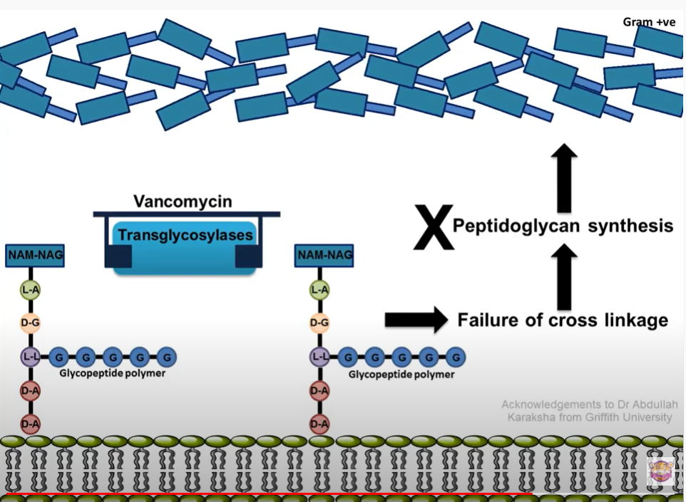
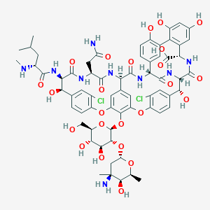
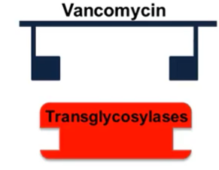
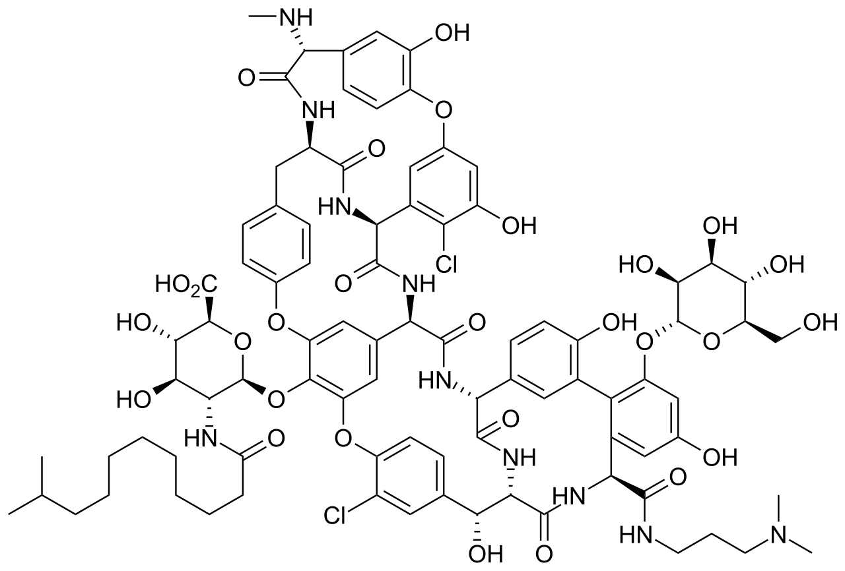
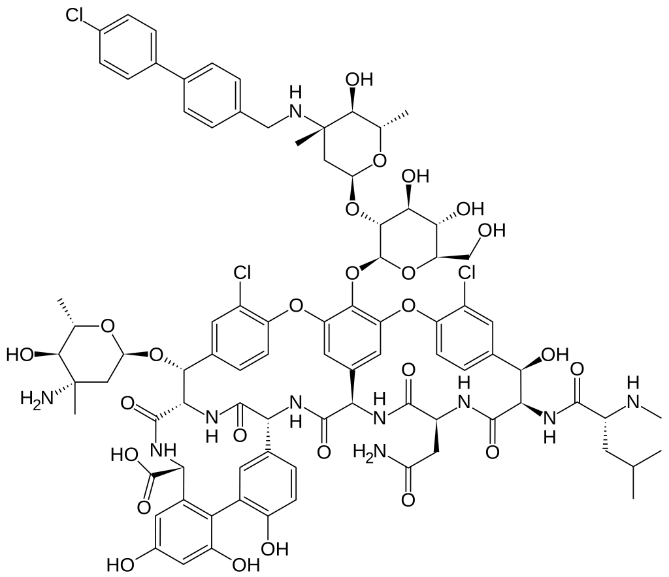
Glycopeptide Mechanism
Vancomycin
Dalbavancin
Oritavancin

Slide 23
Guideline Glycopeptide
Vancomycin (IV/PO)
  Gram positive coverage only!
    Includes MRSA
  Oral only appropriate for Clostridium difficile
Dosing Considerations
  Dosed mg/kg basis
  Requires renal dose adjustments
    Accumulate w/ impaired clearance → ↑ADRs
  AUC + Trough level monitoring
    For therapy safety & efficacy
Highlight Adverse Effects
    AUC > 600, Tr > 20 mcg/ml → AKI (usually ATN)
    Hypersensitivity = Infusion Reaction (“Red Man Syndrome”)
      Can be managed/prevented!
        Slow infusion rate
        Medicate (antihistamine, steroid)

Slide 24
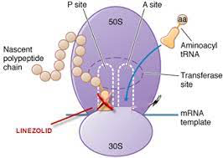
Oxazolidinone Mechanism
Linezolid
Tedizolid

Slide 25
Guideline Oxazolidinone
Linezolid (IV/PO)
  Gram positive coverage only!
    Includes MRSA and VRE
      Only oral option that robustly covers most strains of MRSA (vs CA-MRSA)
  Bioavailability ~100% (dosing 1:1)
Highlight Adverse Effects
    Usually rare – most ADRs associated with therapy > 14 days
      Myelosuppression, Neurotoxicity
    Serotonin syndrome
      Exercise caution when co-prescribed with agents that increase serotonin (mostly mental health meds)
        Contraindicated if received MAOI (a specific antidepressant class) within 14 days

Slide 26
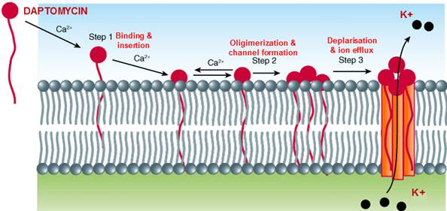
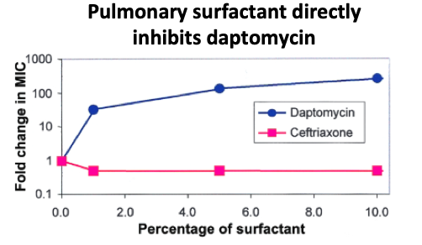
Where’s daptomycin?

Slide 27
Aspiration Pneumonia
Inhalation of GI contents
  Alcoholism, dysphagia, reflux
  Anterograde (oropharyngeal contents)
    Less common
    Gram + > anaerobic > gram – coverage
  Retrograde (gastroesophageal contents)
    More common
    Anaerobic and gram – coverage
  Pneumonitis >>> Aspiration PNA
Highlight Anaerobic Coverage
  Not empirically required per IDSA Guidelines
  β-lactam #s, Carbapenems, Moxifloxacin, Clindamycin, Metronidazole

Slide 28
Clindamycin Mechanism
C = Clindamycin
Notes:
C = clindamycin, M = macrolides, T = tetracyclines

Slide 29
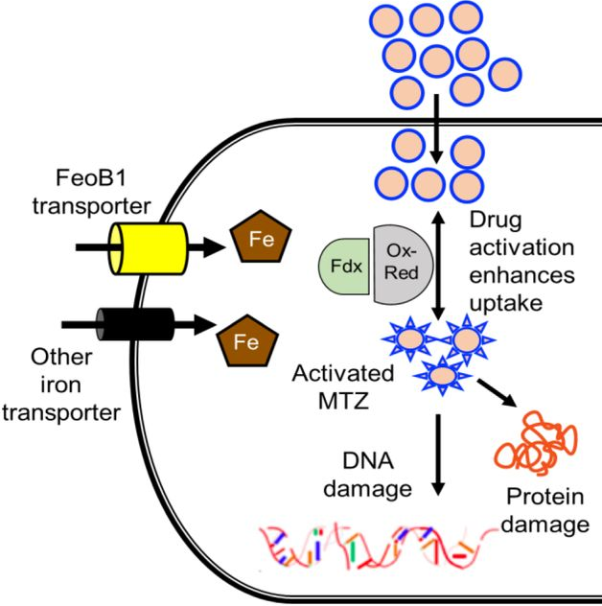
Metronidazole Mechanism
Metronidazole

Slide 30
Miscellaneous Antimicrobials
Metronidazole (IV, PO)
  Anaerobic coverage only!
  Dosing Considerations
    Oral bioavailability ~100%
    Dosed TID to QID
    Lots of drug interactions – kinetic inhibitor (usually → higher exposure)
  Highlight Adverse Effects
    Headache, N/V/D (esp with alcohol intake), metallic taste
Clindamycin (IV, PO)
  Gram positive and anaerobic coverage only!
  Dosing Considerations
    Oral bioavailability ~ 90%
      Caution using for internal infections below diaphragm and
      CNS infections (poor penetration/coverage)
    Dosed TID to QID
  Highlight Adverse Effects
    C. difficile colitis, N/V/D, metallic taste

Slide 31
Viral Pneumonia
Pearls
  Usually diagnosed on rapid antigen screen/respiratory panel (ex. Biofire)
  Seasonal incidence/patterns
Treatment
  Mostly supportive care
  Antivirals rarely used
    Major exceptions = COVID, Influenza

Slide 32
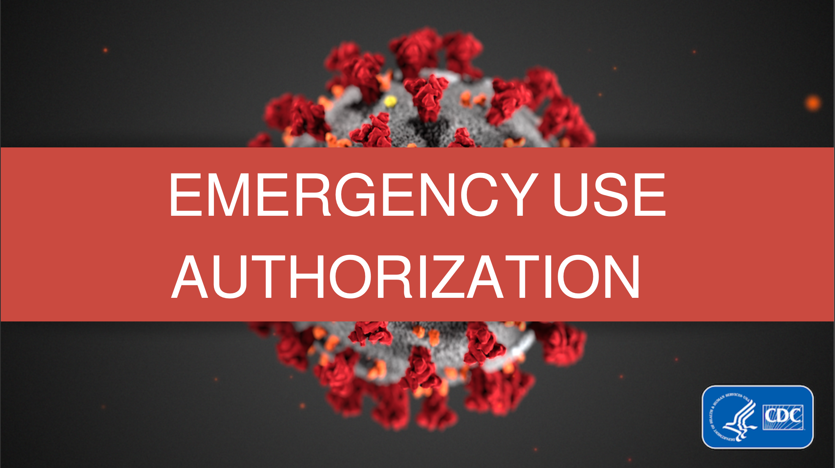

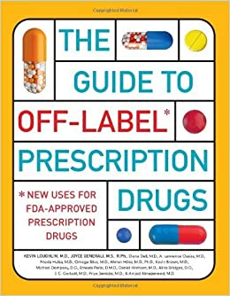
COVID PNA
SARS-Coronavirus
  Prevention
    Immunization → STILL controversial
  Treatment
    Azithromycin → Tocilizumab
    Supportive Care (“Cocktail”) → STILL controversial
      Antihistamine (H2RAs)
        Mixed evidence…now guidelines rec’d against
      Inhaler treatments (NOT nebulizers!!!)
      Intravenous fluids
      Oxygen
      Vitamins?
        Ascorbic acid, cyanocobalamin, thiamine, zinc
Notes:
DNA viruses

Slide 33
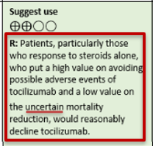
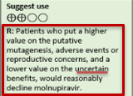
Unique Perspective
Bidirectional practice shifts
  Agents listed as suggest use to recommended against
  Agents listed as recommended against to suggest use
  Great variation in clinical practice…still exists
Novel guideline language + counter-logic evidence
Notes:
DNA viruses

Slide 34
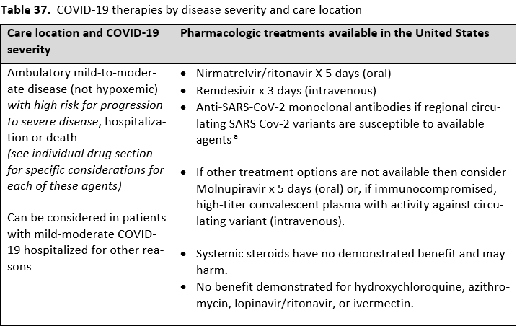
Current IDSA Guidelines

Slide 35

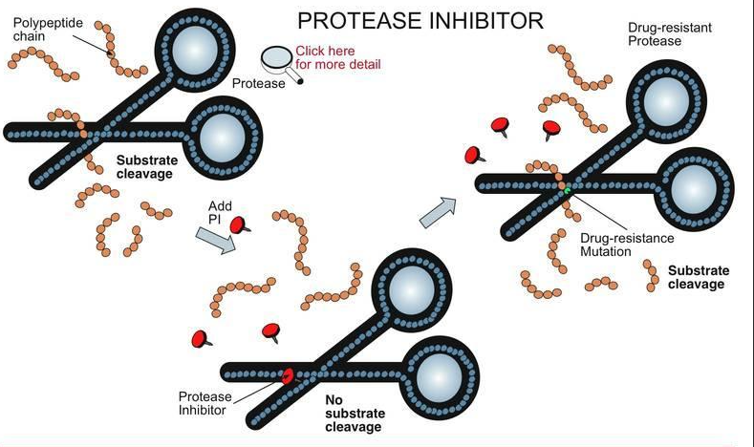
Nirmatrelvir/ritonavir Mechanism
Ritonavir
(HIV-3CL, #nirmatrelvir metabolism)
Nirmatrelvir
(SARS-CoV-2-3CL)

Slide 36
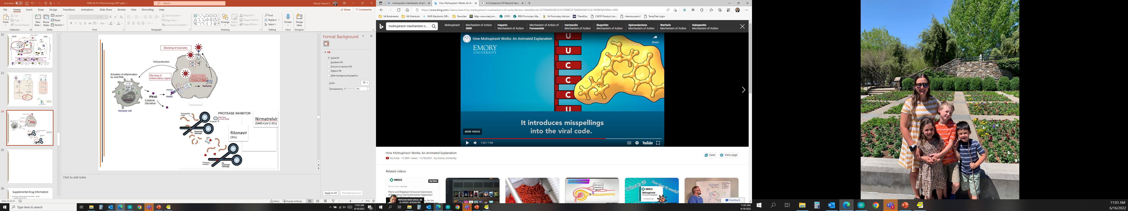
Molnupiravir Mechanism
Molnupiravir

Slide 37
Supplemental Drug Information
Nirmatrelvir/ritonavir (PO)
  Highlight Adverse Effects
    Diarrhea, dysgeusia (6%), HTN?
  Drug Information Pearls
    Initiate within 5 days of symptom onset; treat for 5 days
    Requires renal adjustment
    Lots of drug interactions
Molnupiravir (PO)
  Highlight Adverse Effects
    None reported greater than placebo group…benign?
      Bone-cartiliage toxicity → not recommended for “growing/developing” patients < 18 years
      Embryo-fetal toxicity → not recommended during pregnancy or breast feeding
        Contraception for females 4 days after last dose….for males AT LEAST 90 DAYS after last dose
  Drug Information Pearls
    Initiate within 5 days of symptom onset; treat for 5 days

Slide 38
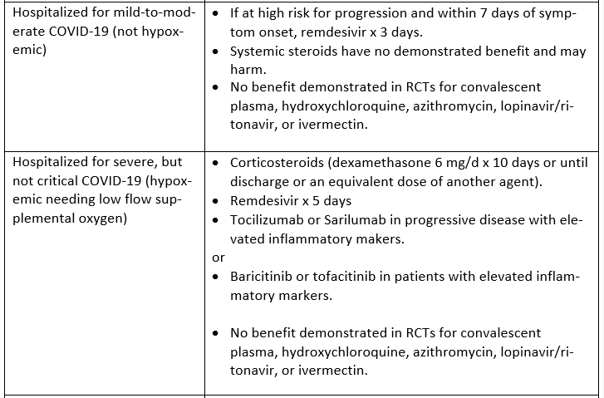
Current IDSA Guidelines

Slide 39
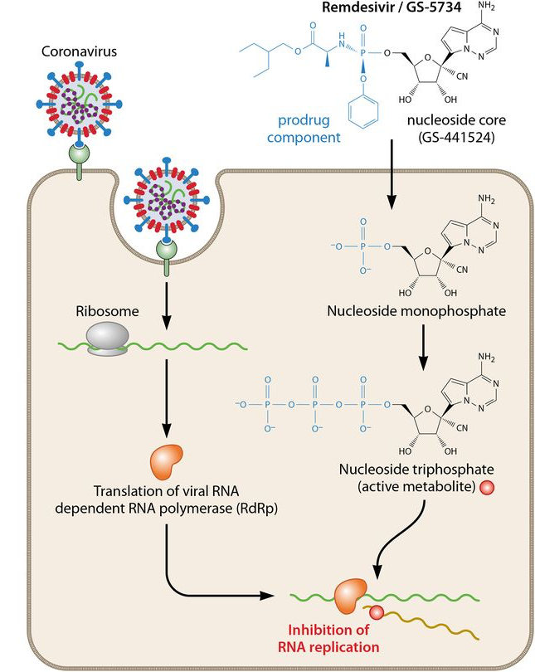
Remdesivir Mechanism

Slide 40
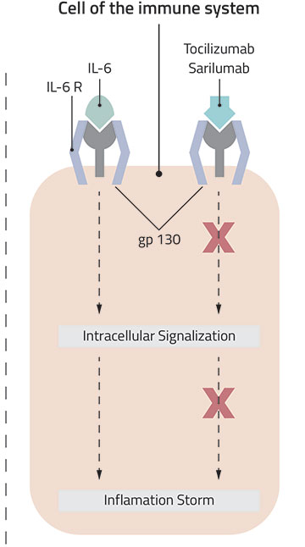
IL-6 Inhibitors Mechanism

Slide 41
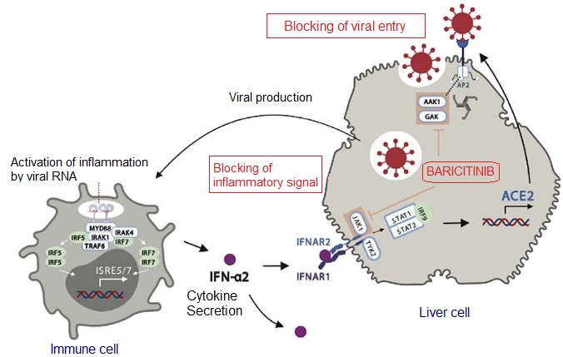
Janus Kinase Inhibitors Mechanism
TOFACITINIB

Slide 42
Supplemental Drug Information
Remdesivir (IV only)
  Highlight Adverse Effects
    Bradycardia/heart block, hypotension, transaminitis…infusion reaction
  Drug Information Pearls
    Avoid if hepatic or renal impairment
    MAY reduce time to recovery
Sarilumab, Tocilizumab (Parenteral Only – IV/SQ)
  Highlight Adverse Effects
    Hepatic impairment (hypercholesterolemia, transaminitis)
    Infusion reactions (flu-like symptoms)
    Opportunistic infections (bacterial, fungal, viral)
      Latent organism activation (exs. TB, HSV)
    Neutropenia, thrombocytopenia
  Drug Information Pearls
    Sarilumab labelled as tocilizumab alternative
Baricitinib, Tofacitinib (PO)
  Highlight Adverse Effects
    BBW for serious infections, malignancies, CV events, thrombosis, mortality…
    Renal + hepatic impairment concerns/considerations
  Drug Information Pearls
    Lots of drug interactions

Slide 43
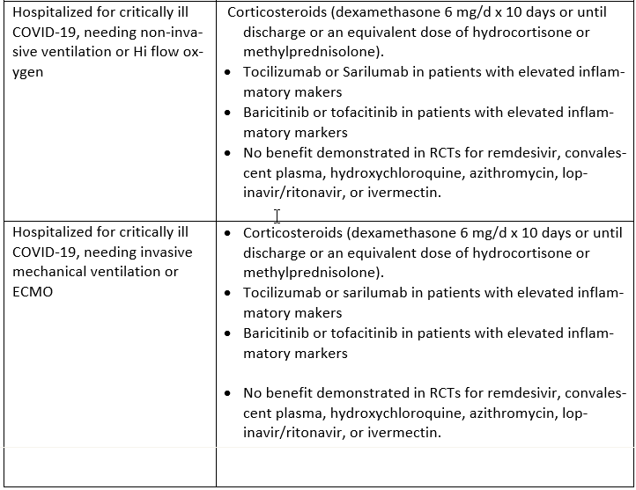
Current IDSA Guidelines

Slide 44
Seasonal Influenza
ACCP: Update in Therapeutics 2018.

Slide 45
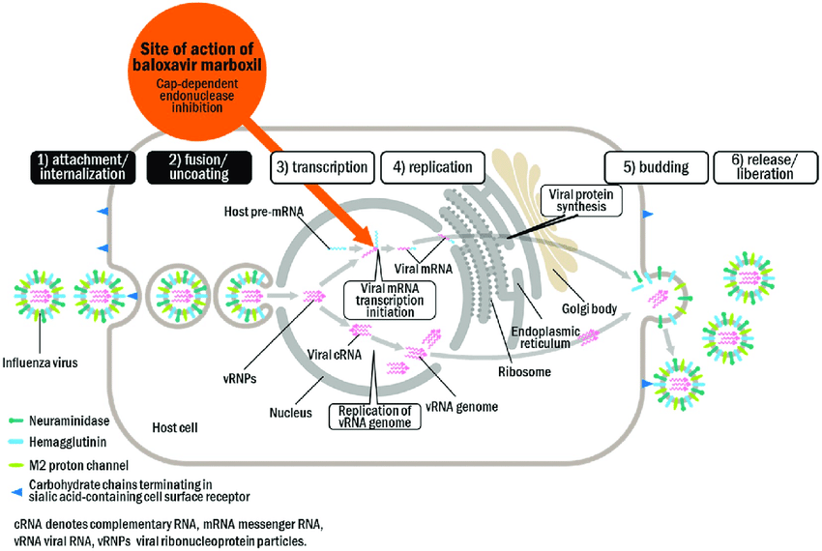
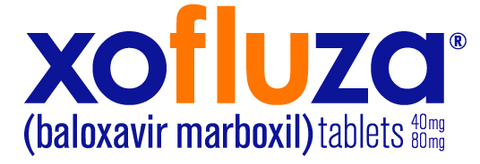

Site of action of oseltamivir and zanamivir
Neuraminidase
inhibition

Slide 46
Supplemental Drug Information
Oseltamivir (PO), Zanamivir (INH)
  Adverse Effects
    Oseltamivir: N/V/D (2-16%), headache (2-17%)
    Zanamivir: Bronchospasm, cough
  Drug Information Pearls
    Initiate within 48 hours of symptom onset -> reduce duration 1-1.5 days
    Oseltamivir requires renally adjustment
    Treatment duration = 5 days
Baloxavir (PO)
  Adverse Effects
    N/V/D (2-3%), headache (1%)
  Drug Information Pearls
    Initiate within 48 hours of symptom onset -> reduce duration 1-1.5 days
    Weight-based dosing (80kg)
    Treatment duration = 1 dose
    Avoid cations (antacids, dairy products, etc) due to chelation inhibited absorption
      Separate by 1-2 hours before/after

Slide 47
Fungal Pneumonia
Pearls
  Incidence low (highest in immunocompromised)
  Cultures resistant to grow (5+ days)
  Diagnosis of exclusion (and usually by ID specialist)
Treatment
  Broad coverage until culture
    Usually azole antifungals (ex. fluconazole) 1st line
    Refer to Dr. Cluck’s Antifungals Lecture ☺

Slide 48
Additional Care
Supportive Care
  Antipyretics/Analgesics
  Bronchodilators/Mucolytics
  Cough suppressants/Expectorants
Preventative Care = Vaccination
  Pneumococcal, Seasonal influenza
    Look forward to Dr. Thigpen’s lecture :D

Slide 49
Highlight Pharmacotherapy Resources
Infectious Diseases Society of America
  Guidelines by organ and sometimes by organism
Medication Databases
  Lexi-Comp, Micromedex
Therapy QuickGuide
  UpToDate

Slide 50
Respiratory Infections
PAS 523
July 2025
Robert Wood, PharmD, BCCCP, VHA-CM
Adjunct Professor, Milligan College, Physician Assistant Studies Program
Clinical Associate Professor, ETSU College of Pharmacy
Acute Care Clinical Pharmacist Practitioner, James H. Quillen VAMC
Robert.Wood5@va.gov

Slide 51
Test Yourself
Which one of the following is a macrolide?
  Clarithromycin
  Clindamycin
  Tobramycin
  Vancomycin
Notes:
A
Clindamycin is not a macrolide – it covers gram positives and anaerobes vs macrolides cover gram positives and atypical organisms.
Tobramycin is an aminoglycoside – it covers gram negatives only.
Vancomycin is a glycopeptide – it covers only gram positives.

Slide 52
Test Yourself
Which one of the following directly inhibits ribosomal production through interfering with protein synthesis?
  Amoxicillin/clavulanate
  Levofloxacin
  Clindamycin
  Daptomycin
Notes:
C
Amox/clav blocks synthesis and repair of cell wall
Levofloxacin inhibits replication and transcription of DNA/RNA
Daptomycin acts through causes loss of selective permeability

Slide 53
Test Yourself
Which of the following antibiotics covers gram negatives only?
  Aztreonam
  Azithromycin
  Doxycycline
  Metronidazole
Notes:
A
Azithromycin covers gram positive and atypicals only.
Doxycycline covers gram positives only.
Metronidazole covers anaerobics only.

Slide 54
Test Yourself
EZ is a 65 YOF in fair health, having a PMH significant for CAD and CHF. Of note, she is allergic to PCN (vomiting). You are seeing her in your primary care clinic where she is HD stable but coughing, wheezing, and clearly not feeling well. Her WBC = 15K, T = 100.4F, HR = 94bpm. Which of the following represents the best regimen for her pneumonia?
  Azithromycin x 5 days
  Piperacillin/tazobactam x 7-10 days
  Levofloxacin x 10-14 days
  Doxycycline + Cefuroxime x 5-7 days
Notes:
D (although you might be worried about cross reactivity with cefuroxime given the PCN allergy…the risk is really only ~5-16% and the allergy is “only vomiting” – not something more serious like anaphylaxis).
Azithromycin monotherapy – not the “best” for 2 reasons: 1) She has comorbidities – treatment algorithm would not recommend monotherapy 2) Azithromycin carries cardiovascular risk – consider avoiding in patients with PMH.
Pip/tazo – this would be for HAP not CAP…and is only available IV.
Levofloxacin – again, not the “best” for 2 reasons: 1) the treatment duration is excessive (=risk for resistance, Cdiff, etc) 2) Levofloxacin also carries cardiovascular risk.
*Note: Just because an antibiotic carries cardiovascular risk/ADRs doesn’t necessarily mean that you can’t use it…but you want to be aware to monitor appropriately/more closely and given other equally viable antibiotic choices, you probably should avoid its use. However, usually a short course in a “stable” patient doesn’t result in significant risk.

Slide 55
Test Yourself
While working in the ER, you see Mr. JB. He is a 87 YOM resident of a LTCF. You recognize him from last week when you admitted him for PNA vs a blood clot in lung. He was treated with IV antibiotics for 2 days before a PNA was ruled out and PE confirmed. Via CXR, serology, and physical exam – you are going to admit him to the ICU for PNA. Which of the following is the best empiric regimen for JB?
  Ceftriaxone + Azithromycin x 7 days
  Cefepime x 7 days
  Meropenem + Levofloxacin + Vancomycin x 7 days
  Piperacillin/tazobactam + Cefepime x 7 days
Notes:
C
Ceftriaxone + azithromycin is how you would treat CAP that required admission to the ICU.
Cefepime monotherapy is how you would treat HAP in a pt not at high mortality risk with no risk factors for MRSA. This patient is 87 (= inherently at high mortality risk), has had a PE (blood clot in his lung) in the last week, and now has PNA. Moreover, he received IV antibiotics x 2 days within the past 90 days.
Piperacillin/tazobactam + cefepime is not the “best” choice for JB for 2 reasons: 1) Uses two B-lactams (this is a no-no because potential resistance can overcome both, the regimen doesn’t take advantage of two different mechanisms to attack pathogen) 2) Doesn’t include MRSA coverage for which he would most likely need given that he could have been exposed to MRSA while he was in the hospital last week.

Slide 56
Test Yourself
Select the inaccurate statement regarding pharmacological management of seasonal flu.
  Baloxavir works by inhibiting influenza viral mRNA transcription initiation.
  Neuraminidase inhibitors must be initiated within the first 48 hours of symptom onset to effectively reduce symptom duration.
  Baloxavir should be used for 7-10 days or until symptoms resolve.
  Zanamivir is only available for inhalation. Oseltamivir is the only oral neuraminidase inhibitor.
Notes:
C
Baloxavir is a one-time dose based on the patient’s weight.

