Slide 1

Sexually Transmitted Infections
PAS 523
July 2025
Robert Wood, PharmD, BCCCP, VHA-CM
Adjunct Professor, Milligan College, Physician Assistant Studies Program
Acute Care Clinical Pharmacist Practitioner, James H. Quillen VAMC
Robert.Wood5@va.gov

Slide 2
Objectives = Physician Assistant Roles
Detail discussed medications’ mechanism
of action, adverse effects, and drug
information pearls
Formulate appropriate pharmacological treatment regimens (drug, dose, route, duration) for sexually transmitted infections
Provide counseling on non-pharmacological measures utilized to prevent sexually transmitted infections

Slide 3
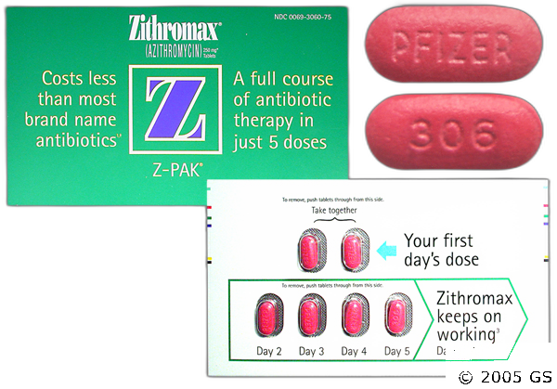
Chlamydia
Chlamydia trachomatis
  Treat patient + partners w/i past 60 days
  1st Line Regimen
    Doxycycline 100mg PO BID x 7 days
  Alternative Regimens
    Azithromycin 1000mg PO x 1 dose
      Less efficacy, particularly in extra-genital
      involvement
        Use “might require” post-treatment
        evaluation/testing
      Preferred for pregnant patients
    Levofloxacin 500mg PO x 7 days

Slide 4
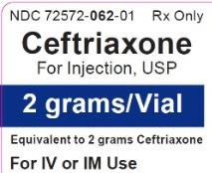
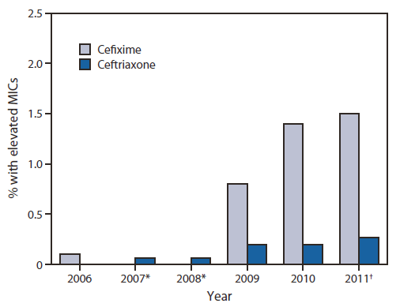
Gonorrhea
Neisseria gonorrhoeae
  Treat patient + partners w/i past 60 days
  1st Line Regimen
    Ceftriaxone 500mg IM x 1 dose
      Coinfection w/ Chlamydia common
        Co-treatment only if coinfection not excluded
  Alternative Regimens
    Azithromycin 2000mg PO x 1 dose
    + Gentamicin 240mg IM x 1 dose
    ORAL cephalosporins (Cefixime 800mg PO x 1 dose)
      Less efficacy and pharmacokinetic concerns --> “3rd…Last Line”

Slide 5


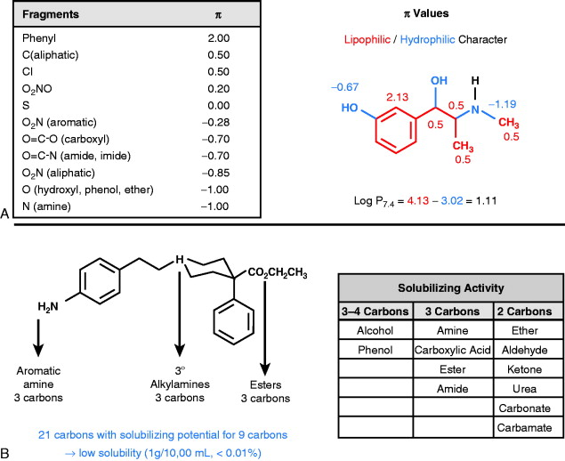
Syphilis
Treponema pallidum
  Treat patient + partners w/i past 90 days
  1st Line Regimens
    Primary/Secondary/Early Latent
      Benzathine PCN G IM x 1 dose
    Tertiary/Late Latent
      Benzathine PCN G IM weekly x 3 doses
    Neuro/ocular/otosyphilis
      Aqueous crystalline PCN G IV
      q4hours or CIVI x 10-14 days

Slide 6
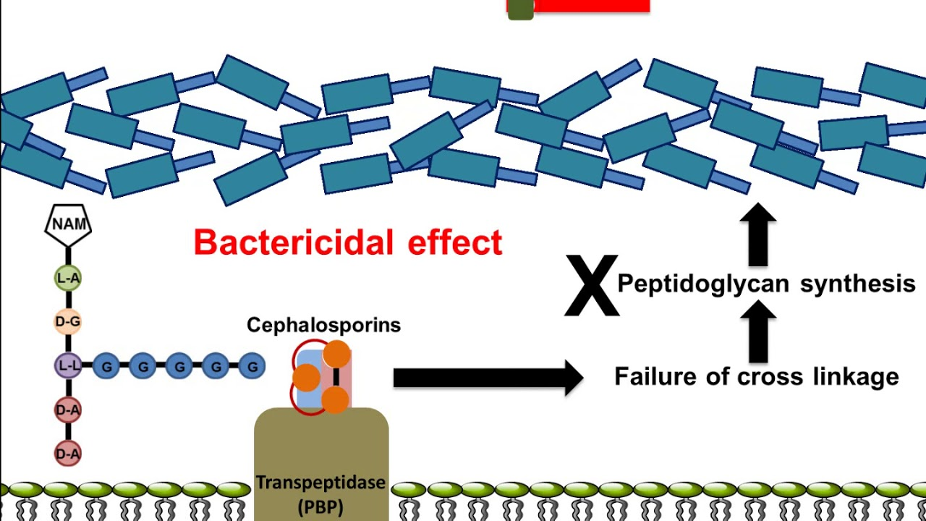
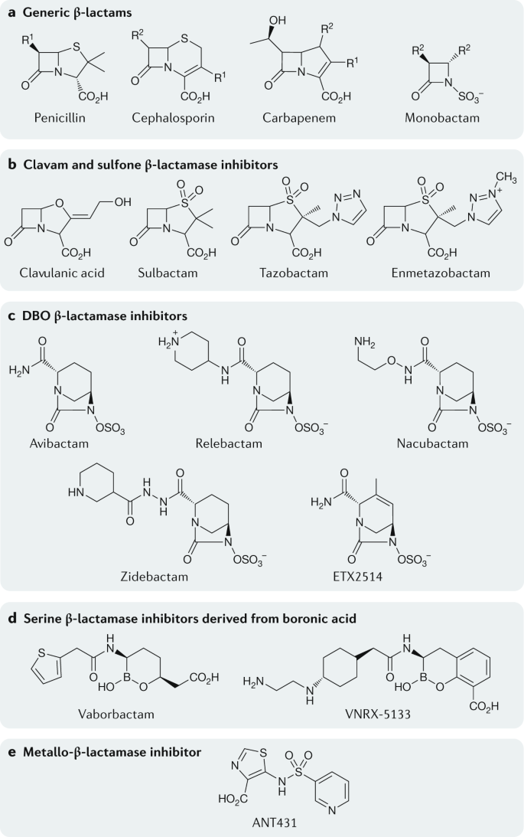
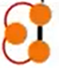
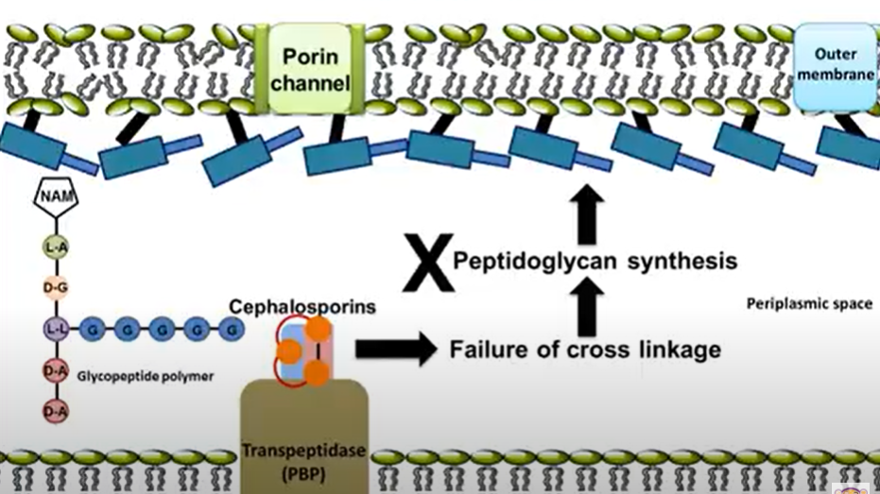
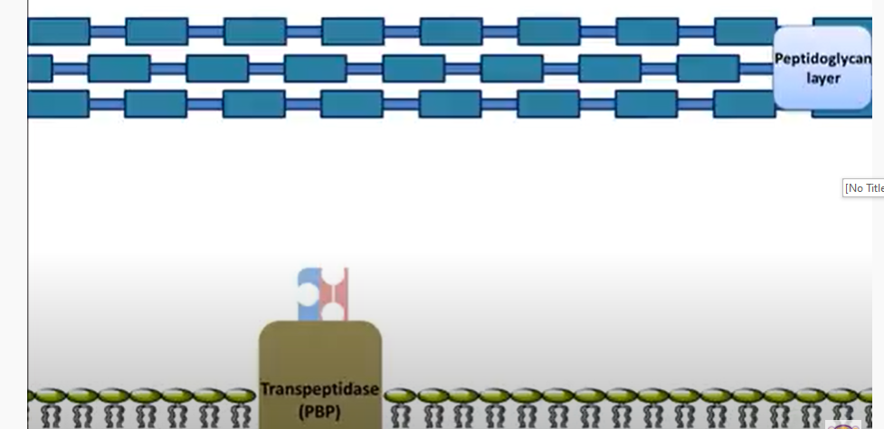
Beta-Lactam Mechanism
Gram + Organism
β-lactam
β-lactams
Gram - Organism
β-lactams
PBP = “Penicillin” Binding Protein

Slide 7
Guideline Beta-Lactams
Penicillins
  Aqueous (IV)/Benzathine (IM) PCN G
    Highlight Adverse Effects
      Hypersensitivity (usually downplayed) is a bigger risk here
        Ex. Jarisch-Herxheimer Post-Treatment Reaction
        Efficacy ↑↑ → desensitization protocols
Cephalosporins
  Ceftriaxone (IM/IV), Cefixime (PO) Oral
    IM → injection site reaction/pain
      Reconstitute with lidocaine to reduce discomfort
Notes:
Mostly in primary/secondary cases
Characterized by flu-like symptoms ± aggravation of lesions
Prevention = awareness (…NSAIDs, Steroids…)
Treatment = supportive, monitoring

Slide 8
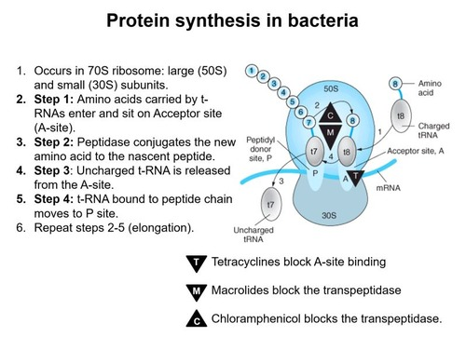
Macrolide & Tetracycline Mechanism
M = Macrolide
T = Tetracycline
Notes:
C = clindamycin, M = macrolides, T = tetracyclines

Slide 9
Guideline Macrolide/Tetracycline
Azithromycin (IV/PO)
  Cardiovascular adversities (ex. QTc ↑)
    Risk? 1 dose but pretty high dose…
Doxycycline (IV/PO)
  Separate from “cations” (antacids, dairy products, supplements)
    Chelation inhibited absorption
      Separate by 1-2 hours before & after
  Highlight Adverse Effects
    N/V/D
      Take with food (just not milk) to decrease incidence + severity
    Photosensitivity (drug-light skin reaction →
    ↑ sunburn/rash risk)

Slide 10
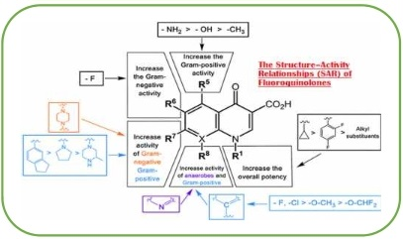
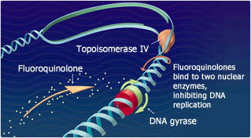
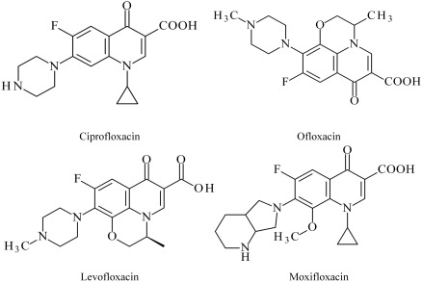
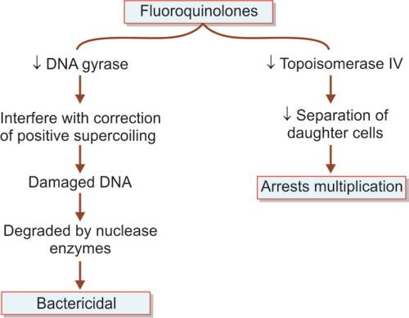
Fluoroquinolone Mechanism

Slide 11
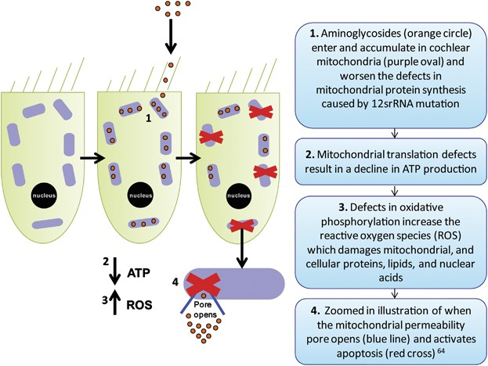
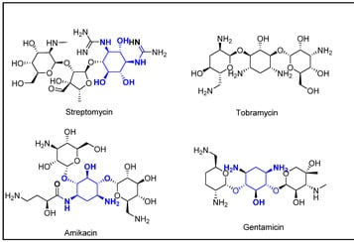
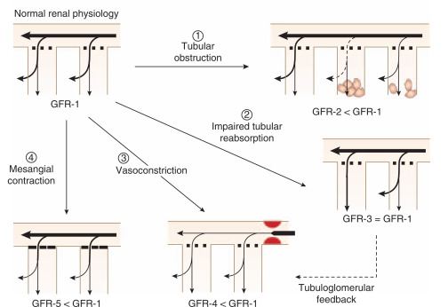
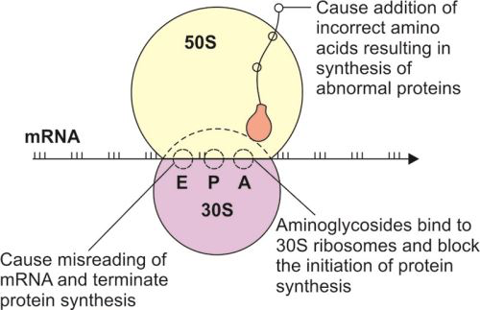
Aminoglycoside Mechanism

Slide 12
Guideline Aminoglycoside/Fluroquinolone
Gentamicin (IM/IV)
  Remember just one time dose
    Renal adjustment not a big deal…AKI unlikely
    No therapeutic monitoring required for STD
Levofloxacin
  Requires renal dose adjustments
    Accumulate w/ impaired clearance → ↑ADRs
  Separate from “cations” (antacids, dairy products, supplements)
    Chelation inhibited absorption
      Separate by 1-2 hours before & after
  Highlight Adverse Effects
    Altered mental status
    Cardiovascular adversities (ex. QTc ↑)
    Dysglycemia (hyper- and hypo-)
    Drug interactions common
    Photosensitivity (drug-light skin reaction → ↑ sunburn/rash risk)
    Tendinopathy

Slide 13
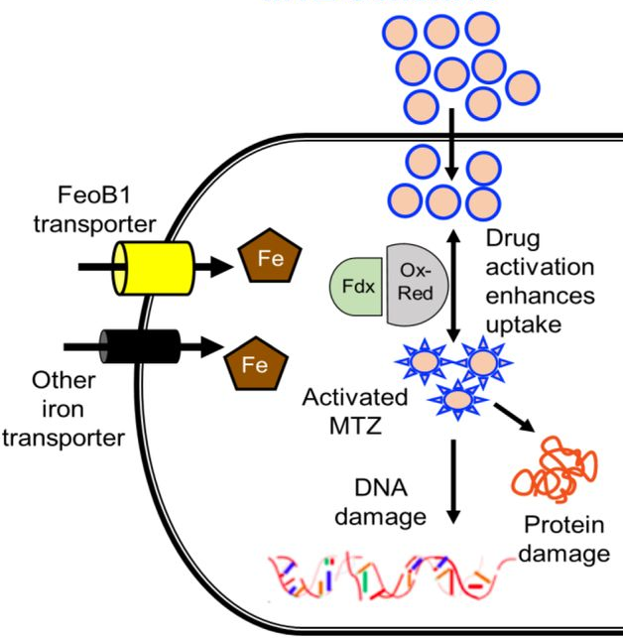
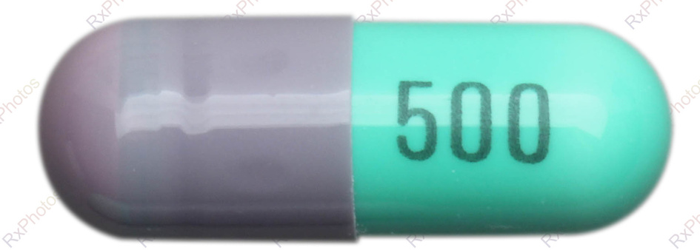
Trichomoniasis
Metronidazole
Trichomonias vaginalis
  1st Line Regimen
    Metronidazole
      2000mg PO x 1 dose (men)
      500mg BID x 7 days (women)
  To avoid reinfection, treat partner
    Men usually asymptomatic carriers

Slide 14
Bacterial Vaginosis
Prevotella sp., Mobiluncus sp., G. vaginalis,
Mycoplasma hominus…
  1st Line Regimens
    Metronidazole
      500mg PO BID x 7 days
      Gel daily x 5 days
    Clindamycin
      Cream nightly x 7 days

Slide 15
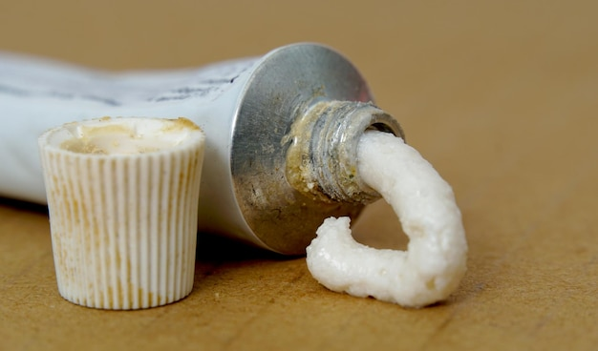
Supplemental Drug Information
Metronidazole (IV, PO, TOP)
  Highlight Adverse Effects
    Headache, N/V/D (esp with alcohol intake), metallic taste
  Drug Information Pearls
    Usually dosed TID to QID
    Lots of drug interactions – kinetic inhibitor
    (usually → higher exposure)
Clindamycin (IV, PO, TOP)
  Highlight Adverse Effects
    IV/PO → C. difficile colitis, metallic taste, N/V/D
      Take with food to decrease GI upset
  Drug Information Pearls
    Usually dosed TID to QID

Slide 16
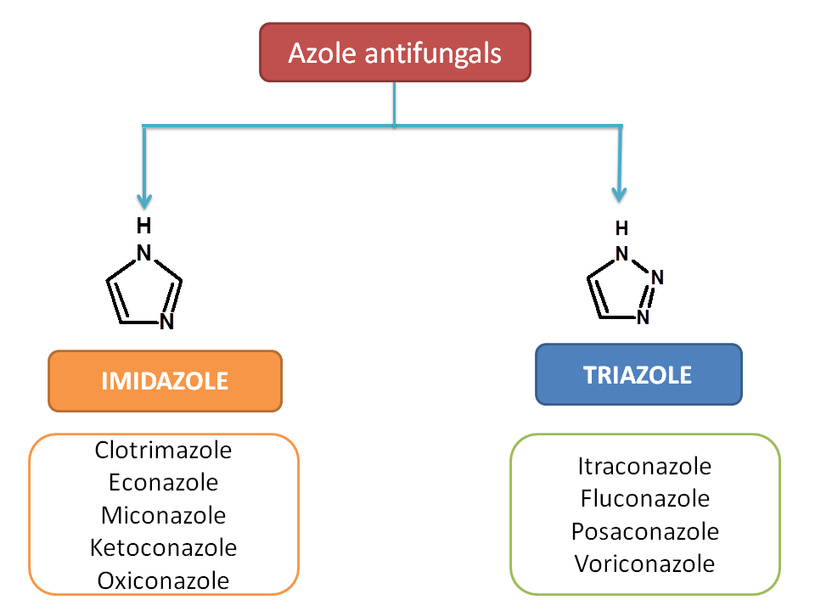
Vulvovaginal Candidiasis
Candida albicans (occasionally other yeasts)
  1st Line Regimens
    Over-the-counter (CDC “do NOT
    self-treat 1st episode”)
      Miconazole suppository/cream daily x 3-7 days
        Except 1200mg suppository = x 1 dose
      Clotrimazole cream daily x 3-14 days
      Tioconazole ointment x 1 dose
    Prescription only
      Fluconazole 150mg PO x 1-2 doses
        2nd dose usually after 2-3 days if not
        significantly resolved
      Terconazole cream/suppository x 3-7 days
  Recurrent VVC ≥ 4 episodes/year
    Longer duration of initial therapy → maintenance
    Treat partner
Tioconazole
Terconazole
MMWR 2021.

Slide 17
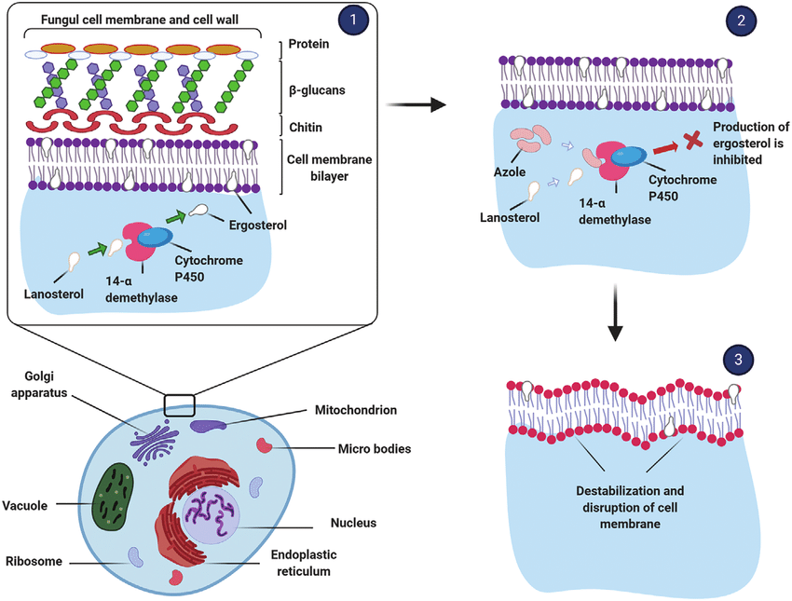

Slide 18

Supplemental Drug Information
Clotrimazole (TOP), Fluconazole (PO/IV) Miconazole (TOP), Terconazole (TOP), Tioconazole (TOP)
  Highlight Adverse Effects
    Headache, rash, transaminitis
  Drug Information Pearls
    Fluconazole oral bioavailability ~ 90%
    Topical therapy cumbersome, messy…less effective…
      Pregnant patients should be treated with topical therapy (vs PO…and for 7 days vs shorter duration)
        Oral azole pregnancy category C, D, or X depending on trimester

Slide 19
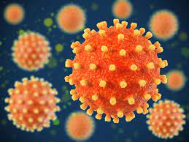
HSV
Herpes Simplex Virus (2>1)
  1st Line Regimens
    Acyclovir, Famciclovir, Valacyclovir
      Appear to equally efficacious (famciclovir = least potent)
        Resistance to one → presumable resistance to all
      Best if started within 1 day of lesion onset
      Treat for 7-10 days or until clinically resolved
        Severe Disease → IV x 2-7 days then PO > 10 days
  Recurrent Infection
    Treat with higher doses for shorter duration
    Imiquimod or tenofovir topically x 5 days for resistant cases (adjunct)
    Foscarnet or cidofovir IV in severe resistant cases until lesions resolve
  Suppressive Therapy
    Indicated when ≥ 6 outbreaks/year
      Decreases transmission risk and outbreak frequency
    Lower dose for extended duration
Notes:
DNA viruses

Slide 20
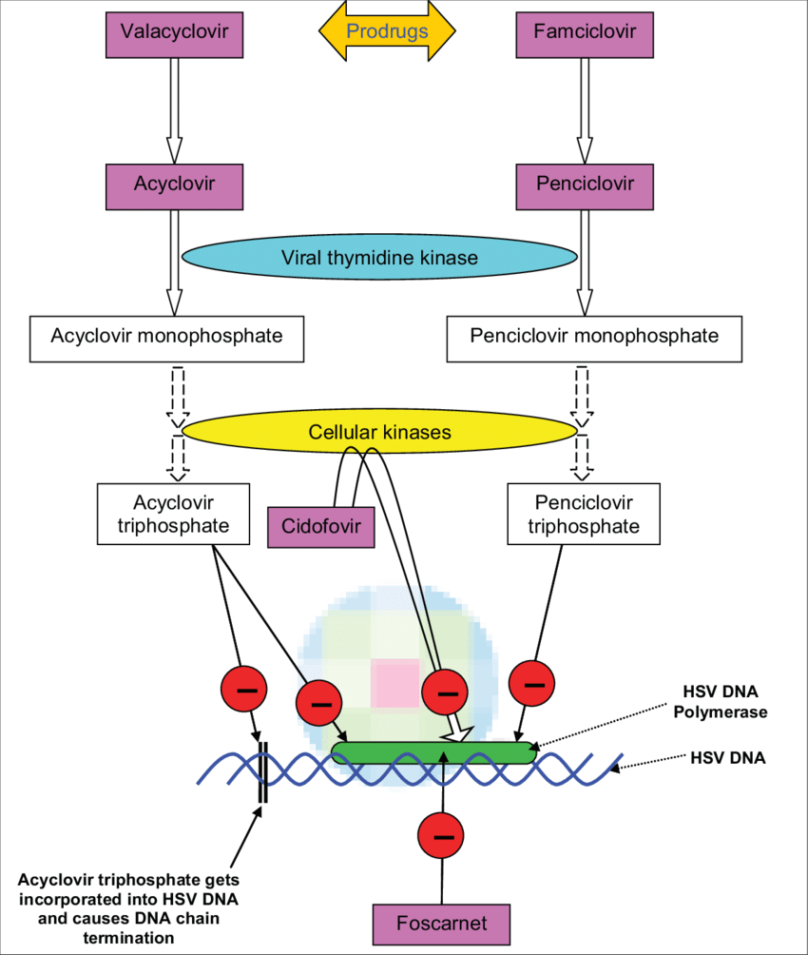

Slide 21
Supplemental Drug Information
Acyclovir (IV/PO), Famciclovir (PO), Valacyclovir (PO)
  Highlight Adverse Effects
    CNS related (confusion, mood changes, hallucinations, seizures), N/V/D
  Drug Information Pearls
    Hydration important to avoid crystallization in urine
    Valacylovir (prodrug) has greater bioavailability → less frequent administration → increased compliance

Slide 22
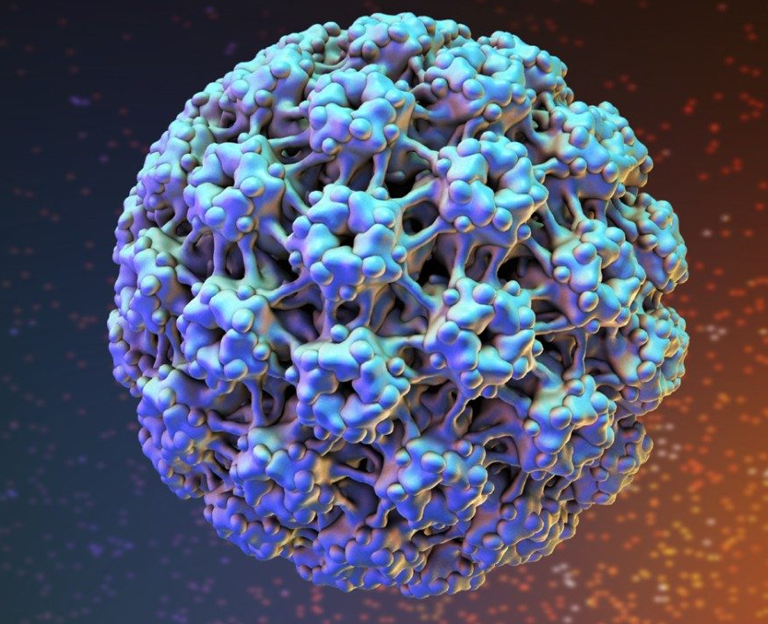
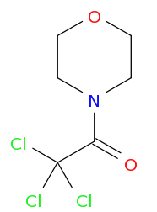
HPV
Human Papilloma Virus
  Prevention = Vaccination
    Gardasil® (9-valent & quadvalent – low risk + high risk types), Cervarix® (bivalent – 16,18…oncogenic/highest risk types)
    Ideally 9-26 year-olds before onset of sexual activity
      CDC recommends routine vaccination at 11-12…before 15th birthday
        0, 6-12 month series
      If 15-26 years old for series, immunocompromised, or for 2 doses < 5 months apart
        0, 1-2, 6 month series
    27-45 year-olds CAN elect to receive
  Treatment
    Patient-applied
      Podofilox solution/gel 3 days on, 4 days off x 4 cycles
      Imiquimod cream 3x/week for ≤ 16 weeks
      Sinecatechins ointment TID for ≤ 16 weeks
    Provider-administered
      Cryotherapy (liquid nitrogen) x q1-2weeks
      Bi/tri-chloroacetic acid
      Surgical removal
Trichloroacetic acid

Slide 23
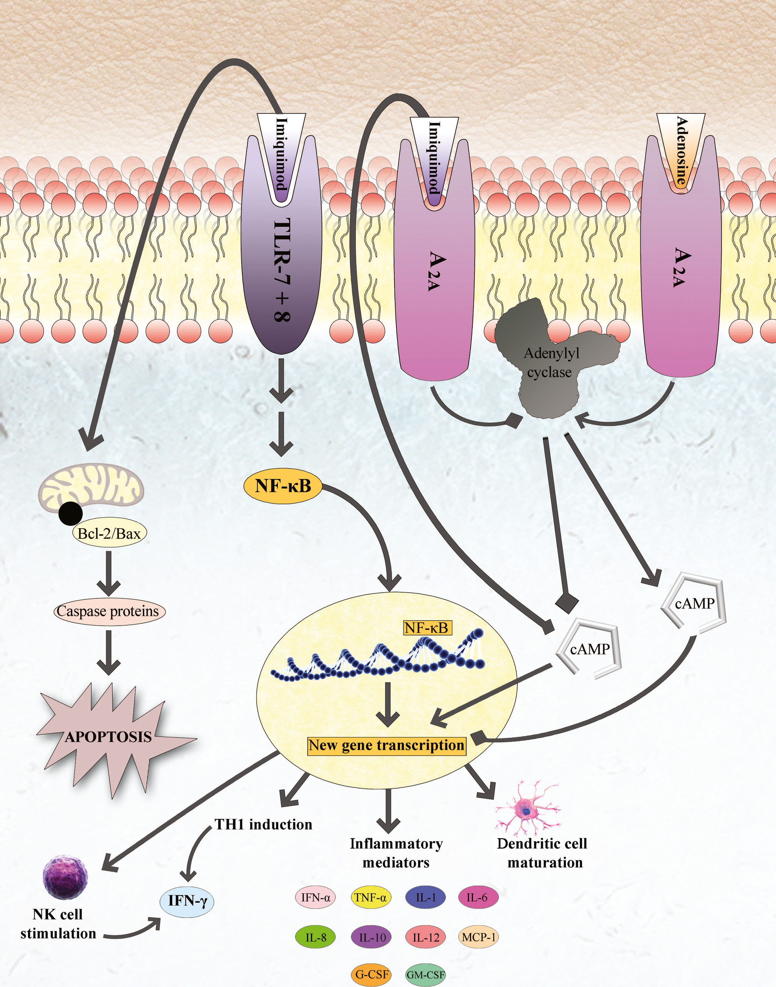
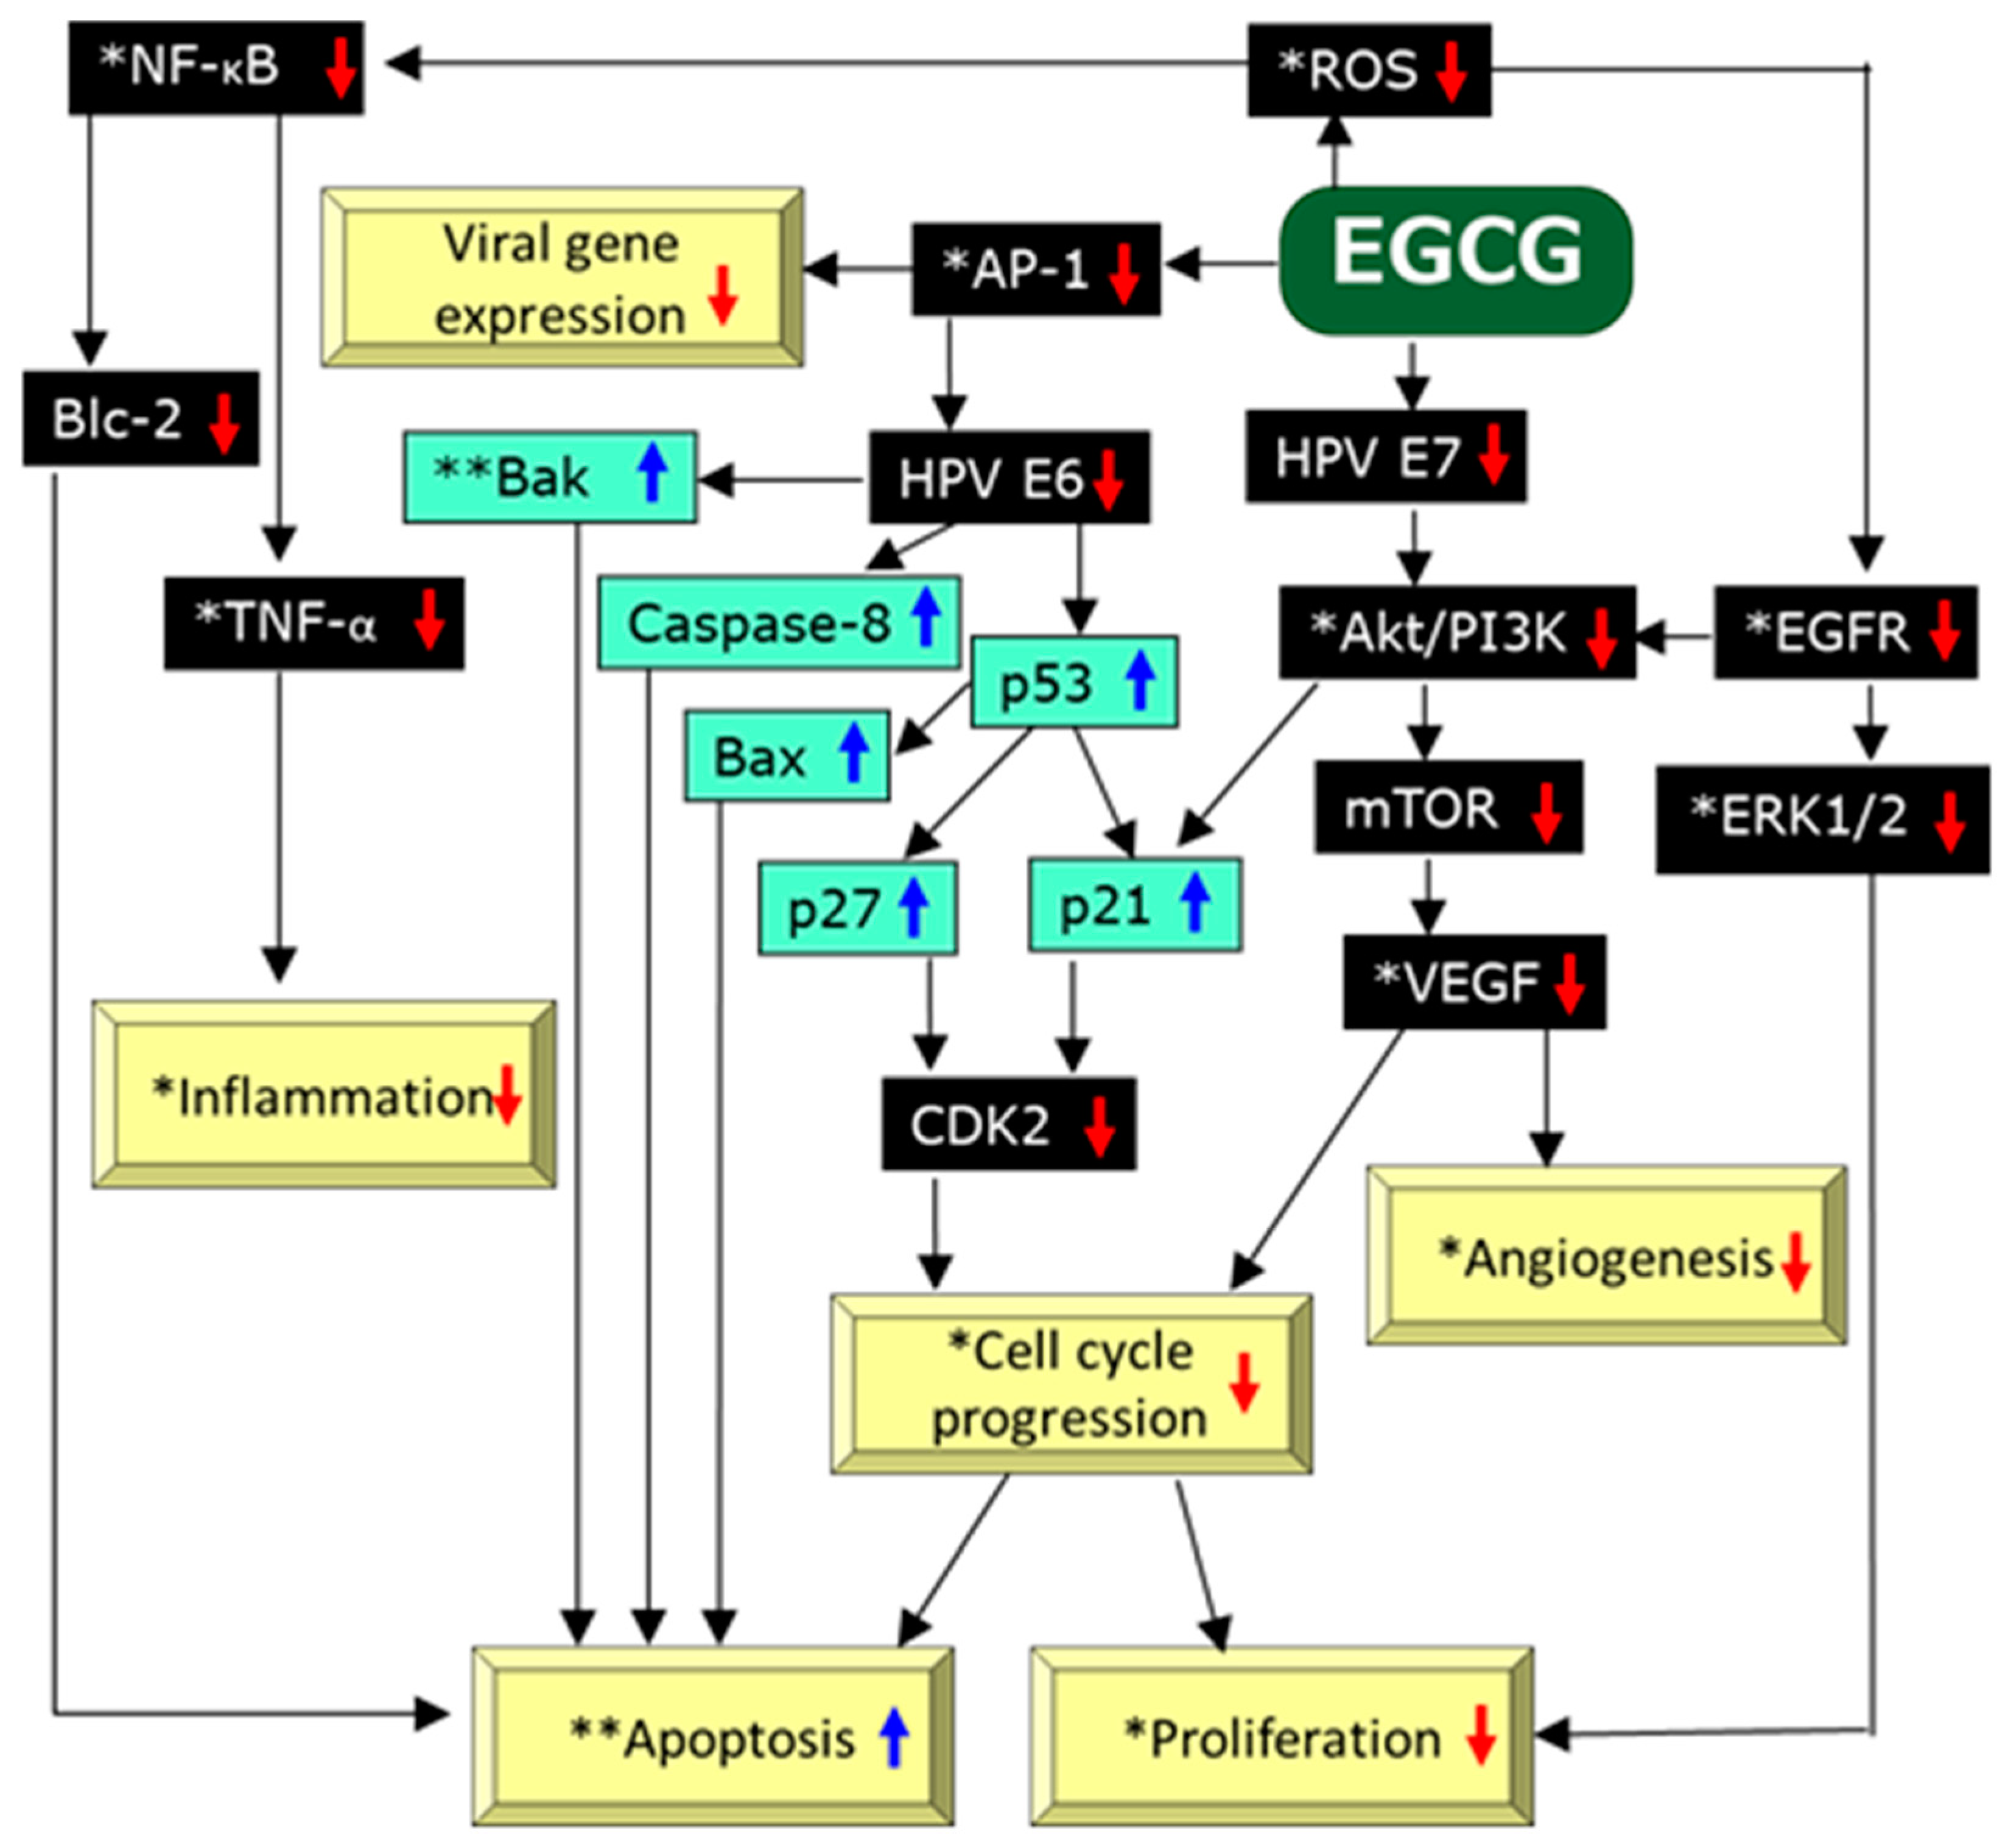
Imiquimod
Sinecatechins
Notes:
Podofilox exact mechanism not known – directly toxic though.

Slide 24
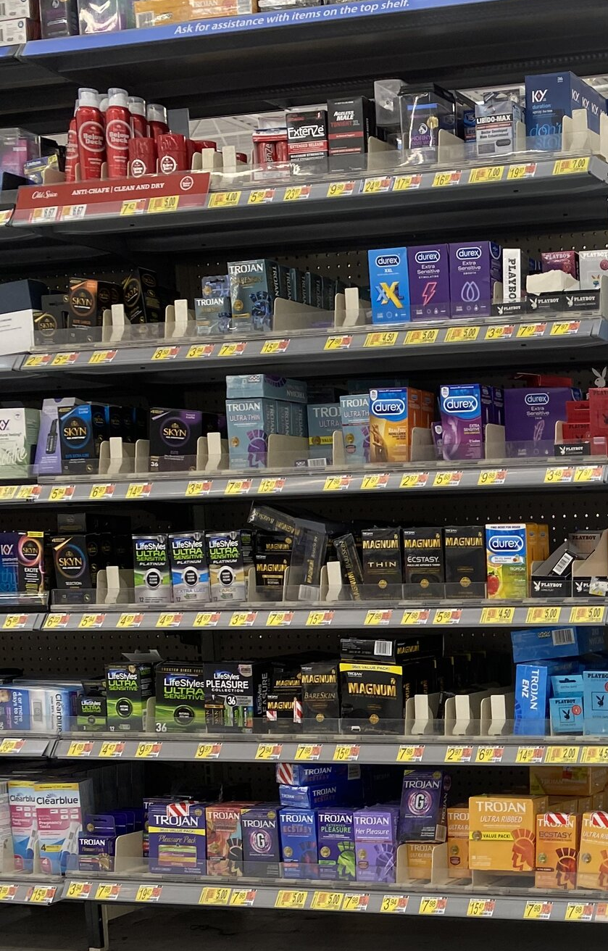
Non-Pharmacologic Measures
Pre-exposure prophylaxis → encourage risky behavior vs prevent disease
  HPV, Hepatitis A, Hepatitis B Vaccination
  Tenofovir (antiretroviral treatment) → ↓transmission of HSV-2 by 51% and HIV by 39%
During-exposure prophylaxis
  Condoms (= “during-exposure prophylaxis”)
    Latex
      HIGHLY effective when used consistently and correctly
      Breakage rates = 2/100
    Polyurethane
      Higher breakage/slippage rates
      Female formulations available
      Little evidence but seems effective against viruses and semen
    Membrane (“natural” or “lambskin”)
      LARGE pores (1500 nm) → viral STDs can pass through!
Lubrication
  Microbicidal/spermicidal NOT recommended
    NOT as effective, shorter shelf-life, increases bacterial UTI risk
    Nonoxynol-9 → damages epithelium → ↑HIV/STD transmission risk?!
  Oil-based weakens condoms → use only water-based
Post-exposure prophylaxis (=genital hygiene)
  Vaginal washing/douching → ineffective
  Might increase risk for STDs (ex. BV, HIV)
MMWR 2021.
Notes:
10x>HIV and 25x>HBV

Slide 25
Highlight Resources
MMWR CDC STD Treatment Guidelines
Medication Databases
  Lexi-Comp, Micromedex
Therapy QuickGuide
  UpToDate

Slide 26
Sexually Transmitted Infections
PAS 523
July 2025
Robert Wood, PharmD, BCCCP, VHA-CM
Adjunct Professor, Milligan College, Physician Assistant Studies Program
Acute Care Clinical Pharmacist Practitioner, James H. Quillen VAMC
Robert.Wood5@va.gov

Slide 27
Test Yourself
Metronidazole inhibits ergosterol synthesis through activity against 14-α-demethylase.
  True
  False
Notes:
False – metronidazole is NOT an azole antifungal.

Slide 28
Test Yourself
Which of the following is the regimen of choice for a patient testing positive for uncomplicated Gonorrhea?
  Ceftriaxone IM x 1 dose
  Benzathine PCN G IM x 1 dose
  Doxycycline x 7 days
  Azithromycin x 1 dose + Ceftriaxone IM x 1 dose
Notes:
A
B – benzathine is the treatment of choice for syphillis (so long as its not neurosyphilis)
C – doxycycline is first line for chlamydia NOT gonorrhea
D – gonorrhea NO LONGER requires concomitant chlamydia coverage for 1st line treatment (SO LONG AS you’re sure Chlamydia workup is negative)

Slide 29
Test Yourself
Select the accurate statement regarding antivirals and their use for STDs.
  It is important to not overconsume fluids while taking an antiviral. This will help concentrate the drug to fight the infection better.
  Valacyclovir is the drug of choice for acyclovir resistant infections given their significant structural differences.
  Acyclovir can cause CNS side effects such as confusion, mood changes, hallucinations, and seizures.
  Famciclovir triphosphate gets incorporated into HPV DNA and causes DNA chain termination.
Notes:
C
A – hydration is very important to reduce the risk of crystallization…and to help clear the infection!
B – valacyclovir is a prodrug of acyclovir → which means automatic resistance!
D – WRONG for 2 reasons… 1) NOT HPV 2) valacyclovir and acyclovir do this to HSV…famciclovir’s active metabolite, penciclovir triphosphate, inhibits HSV DNA polymerase.

Slide 30
Test Yourself
SL is a 22 YOF who complains of vaginal irritation. She attests to newly using a lubricant with microbicide during intercourse. She has no discharge or lesions but did have a small patch of eruptions around her labia. Serology is positive for HSV by PCR, all other tests are negative. She has not been vaccinated “since she had her shots as a kid.” Select any/all accurate recommendations for SL.
  Prescribe acyclovir x 7 days. Instruct her to call you if eruptions not cleared in 6 days.
  Prescribe acyclovir x 7 days for her and any partners in the past 60 days.
  Counsel her to avoid using spermicidal products or water-based lubricants.
  Recommend vaccination today with bivalent Cervarix®.
Notes:
*A – remember…you need to treat until the eruptions have cleared and for at least 7 days whichever is greater.
B – Only a symptomatic partner would need to be treated. This recommendation is for patients afflicted with chlamydia and/or gonorrhea.
C – partially true. She should avoid spermicidal products (as they and douching increase risk for STD/UTI) but water-based lubricants are preferred over oil-based lubricants.
D – almost, but not quite. Vaccination with Cervarix will only protect her from HPV types that cause cancer…not genital warts. She would benefit most from Gardasil…but would have benefited the most if she could have been vaccinated prior to becoming sexually active.

