Slide 1

Gastrointestinal Infections
PAS 523
July 2025
Robert Wood, PharmD, BCCCP, VHA-CM
Adjunct Professor, Milligan College, Physician Assistant Studies Program
Acute Care Clinical Pharmacist Practitioner, James H. Quillen VAMC
Robert.Wood5@va.gov

Slide 2
Objectives = Physician Assistant’s Roles
Detail discussed medications’ mechanism
of action, adverse effects, and drug
information pearls
Formulate appropriate individualized treatment plans for patients with gastrointestinal infections

Slide 3

Antimicrobial Principles
Microbiology of Intraabdominal Infections
  Aerobic and facultative gram + organisms
    Enterococcus, Streptococcus…
  Gram – organisms
    Enterobacter, Escherichia coli, Klebsiella, Proteus
  Anaerobes
    Ileum → (obligates) large intestine →
      Obligates main examples = Bacteroides, Clostridium
Spectrum of Empiric Regimens
  Basic gram + coverage
  Broad gram - coverage
  Anaerobic coverage
ACCP: Update in Therapeutics 2022.

Slide 4
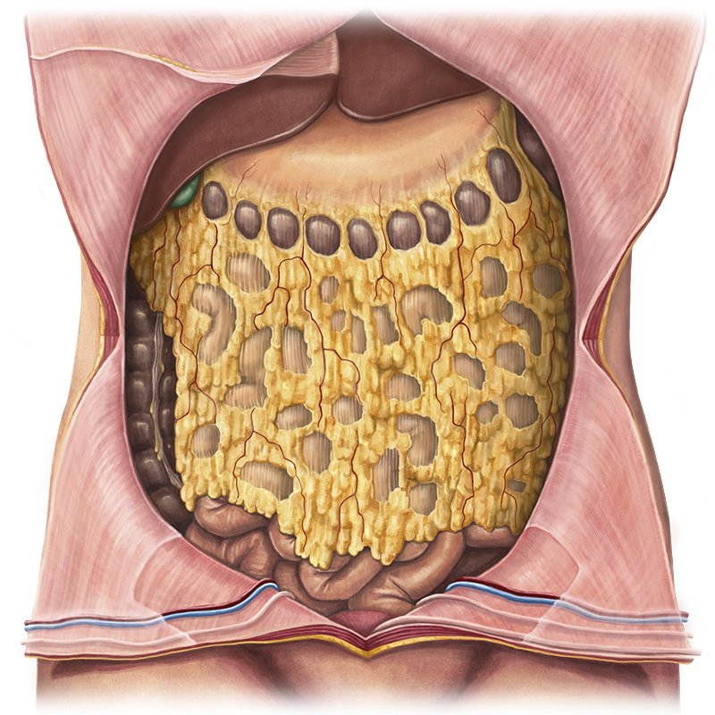
Peritonitis
Primary = disease
  Ascites, CHF, EtOH, hepatitis, malignancy…
Secondary = injury
  Appendicitis, endometritis,
  pancreatitis, perforation, ulceration…
Treat for 4-7 days except…
  < 24 hours if…
    Traumatic bowel injury repaired w/I 12 hours
    Minor perforations of stomach, duodenum, and proximal jejunum
    Appendicitis without evidence of perforation, abscess, or peritonitis
  Until clinical resolution if source control is difficult

Slide 5
1st Line Regimens
Mild to moderate community-developed
  Basic gram+, broad gram -, anaerobes
    No need to empirically cover Pseudomonas
    Exs. Cefoxitin, ticarcillin/clavulanate, ertapenem, moxifloxacin…
      Ceftriaxone + metronidazole, ciprofloxacin + metronidazole…
Severe community-developed or healthcare-acquired
  Broad gram +, broad gram – (incl Pseudomonas), anaerobes
    Exs. Ceftazidime/avibactam, piperacillin/tazobactam, meropenem…
      Cefepime + metronidazole, levofloxacin + metronidazole…tobramycin +…
  If MRSA exposure/history
    Exs. Ceftaroline, Daptomycin, Linezolid, Vancomycin
ACCP: Update in Therapeutics 2022.

Slide 6
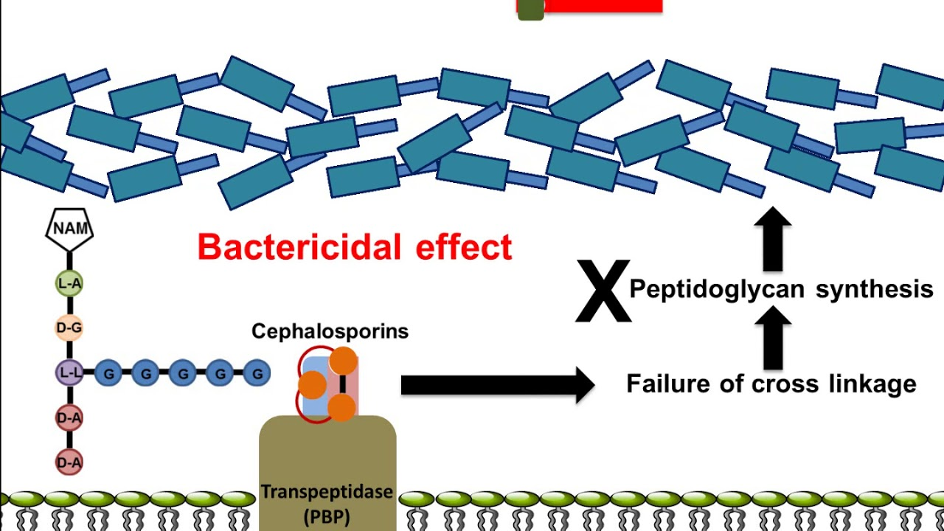
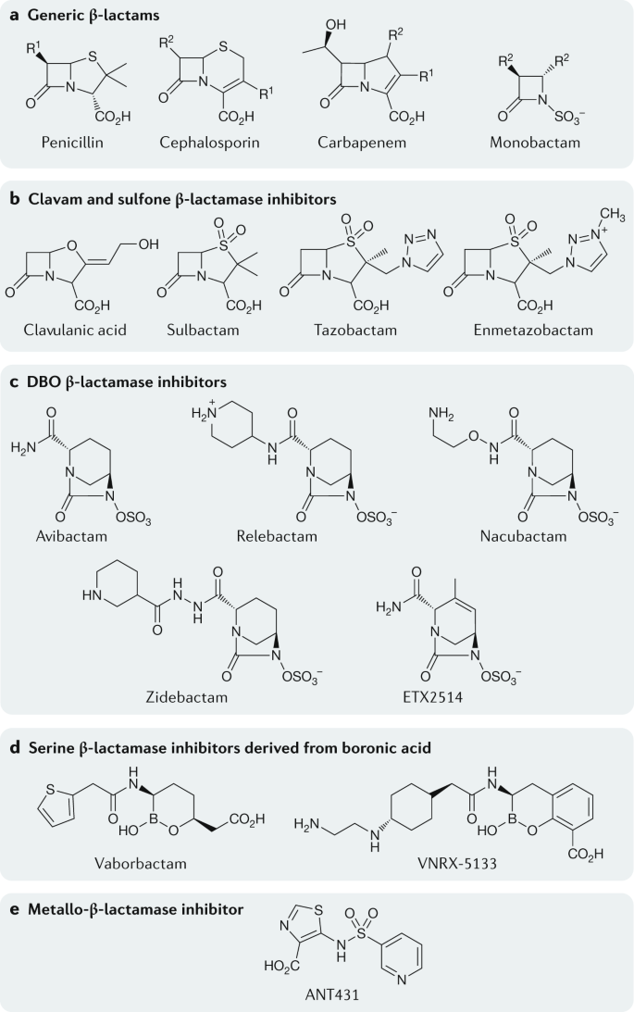
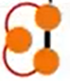
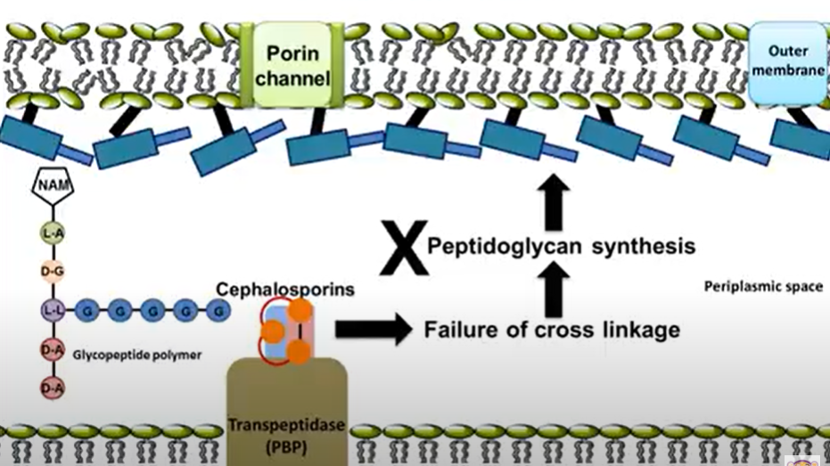
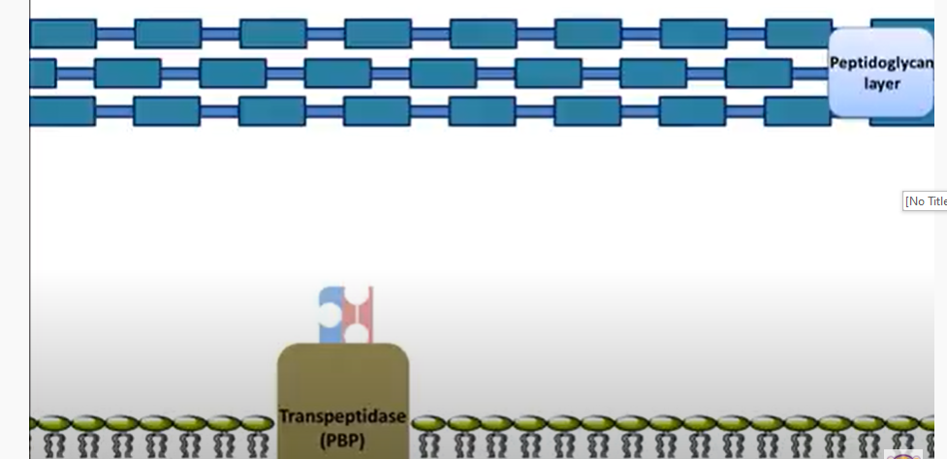
Beta-Lactam Mechanism
Gram + Organism
β-lactam
β-lactams
Gram - Organism
β-lactams
PBP = “Penicillin” Binding Protein

Slide 7
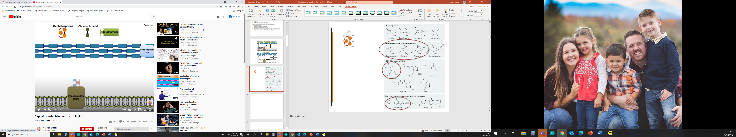

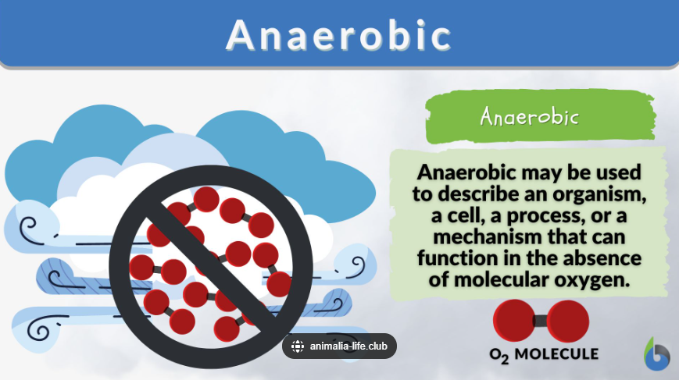
Beta-Lactamase & Inhibitors Mechanism
β-lactam
β-lactamase inhibitor

Slide 8
Beta-Lactam Drug Information Pearls
Dosing Considerations
  Almost all require renal dose adjustments
    Can cause AKI (usually intrinsic – AIN, GN)
    Accumulate w/ impaired clearance → ↑ADRs
Highlight Adverse Effects
  Oral agents → N/V/D (esp w/ β-lactamase inhibitors)
    Take with food to decrease incidence + severity
  Convulsions?
    All abx ↓seizure threshold
      Imipenem/cilastatin > carbapenems > cefepime > other BLs
  Hypersensitivity
    Historically crude, overly associated/reported…but still somewhat common, especially in pediatric patients
      Urticaria, rash (mild → SJS/TEN), SOB, anaphylaxis

Slide 9
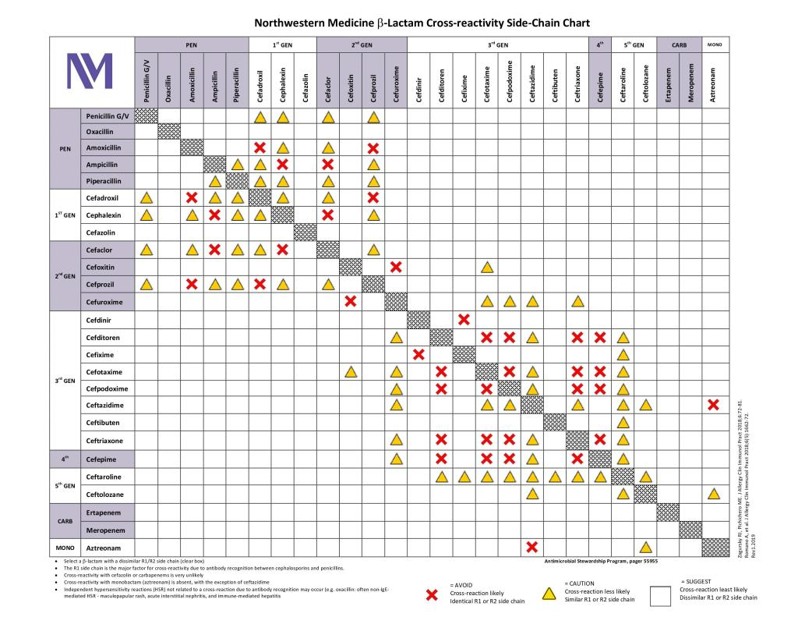
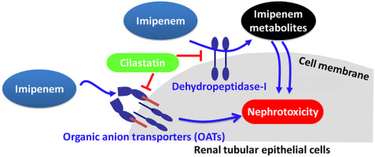
Guideline Beta-Lactams
Intravenous Penicillins
  Ampicillin (±sulbactam), piperacillin/tazobactam, ticarcillin/clavulanate
    Ampicillin covers Acinetobacter
    Piperacillin/tazobactam covers Pseudomonas
Intravenous Cephalosporins
  Cefazolin, cefoxitin, cefotaxime, ceftriaxone (IM also)
    Cefazolin MAINLY covers gram + (only EPK –s)
    Cefoxitin covers anaerobes
    Ceftriaxone IM → injection site reaction/pain
      Reconstitute with lidocaine to reduce discomfort
  Cefepime, ceftazidime (±avibactam), ceftolozane/tazobactam
    Cover Pseudomonas
    BL# for gram-negative resistance, including ESBL-producers
  Ceftaroline
    Covers MRSA
Intravenous Carbapenems
  Ertapenem
    Least broad coverage
      No Pseudomonas, Enterococcus, Acinetobacter sp
  Imipenem/cilastatin
  Meropenem (+/- vaborbactam)
    BL# for gram-negative resistance, including CRE infection

Slide 10
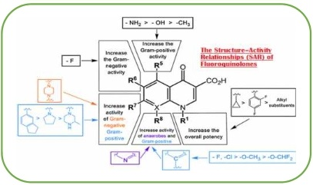
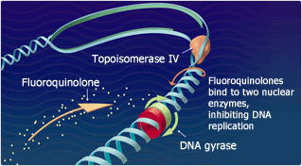
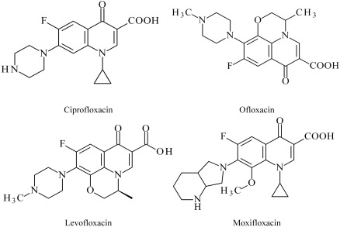
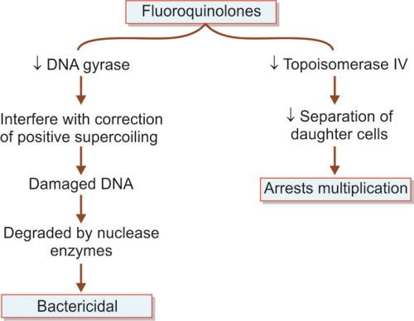
Fluoroquinolone Mechanism

Slide 11

Guideline Fluroquinolones
Ciprofloxacin, Levofloxacin, Moxifloxacin (IV/PO)
  Only PO options that cover Pseudomonas
    ~70% susceptibility/30% resistance
  “Moxi”floxacin covers anaerobes
Dosing Considerations
  Bioavailability ~ 100% (dosing 1:1)
    Ciprofloxacin dosing nuances (BID, IV different than PO)
  Require renal dose adjustments
    Accumulate w/ impaired clearance → ↑ADRs
  Separate from “cations” (antacids, dairy products, supplements)
    Chelation inhibited absorption
      Separate by 1-2 hours before & after
Highlight Adverse Effects
    Altered mental status
    Cardiovascular adversities (ex. QTc ↑)
    Dysglycemia (hyper- and hypo-)
    Drug interactions common (more with ciprofloxacin)
    Photosensitivity (drug-light skin reaction → ↑ sunburn/rash risk)
    Tendinopathy

Slide 12
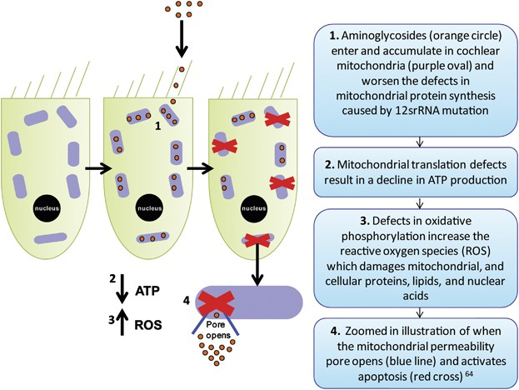
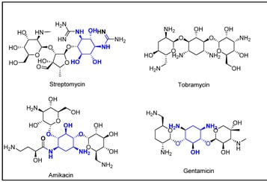
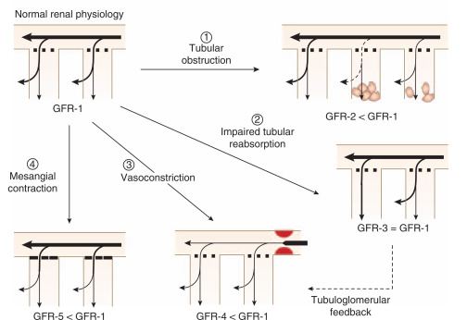
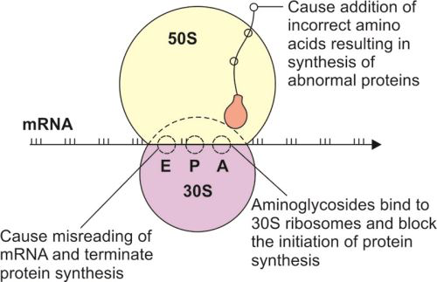
Aminoglycoside Mechanism

Slide 13
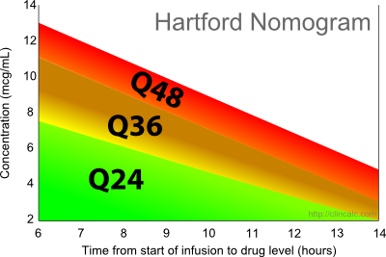
Guideline Aminoglycosides
NO oral
Intravenous
  Amikacin, Gentamicin, Tobramycin
    Gram negative coverage only!
      Includes Pseudomonas
    All require renal dose adjustments
      Can cause AKI (usually intrinsic – ATN)
      Accumulate w/ impaired clearance → ↑ADRs
    Amikacin dosing 3x gentamicin, tobramycin
    Tobramycin inhaled formulation
Highlight Adverse Effects
    High peak levels (usually not drawn, from too high dose)
      Ototoxicity
    High trough levels (>2mcg/ml, >6mcg/ml for amikacin,
    from too high cumulative dosing)
      Nephrotoxicity

Slide 14
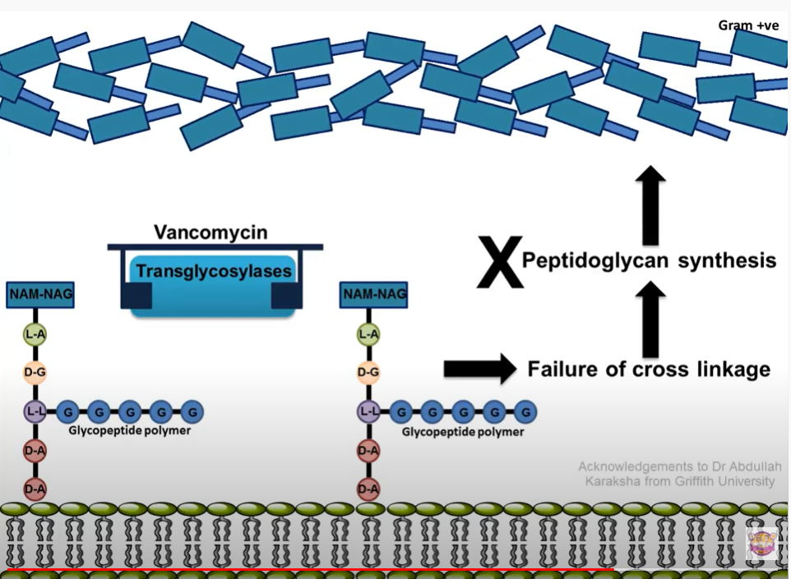
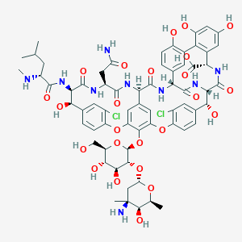
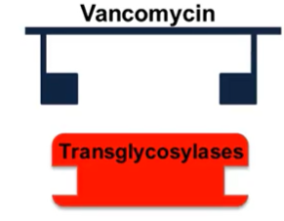
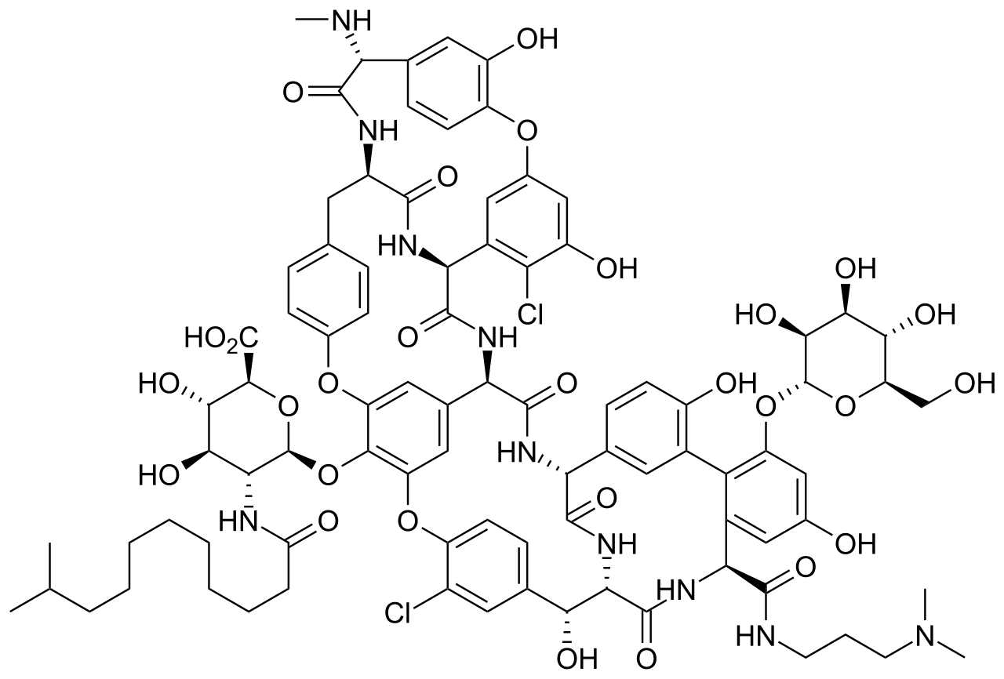
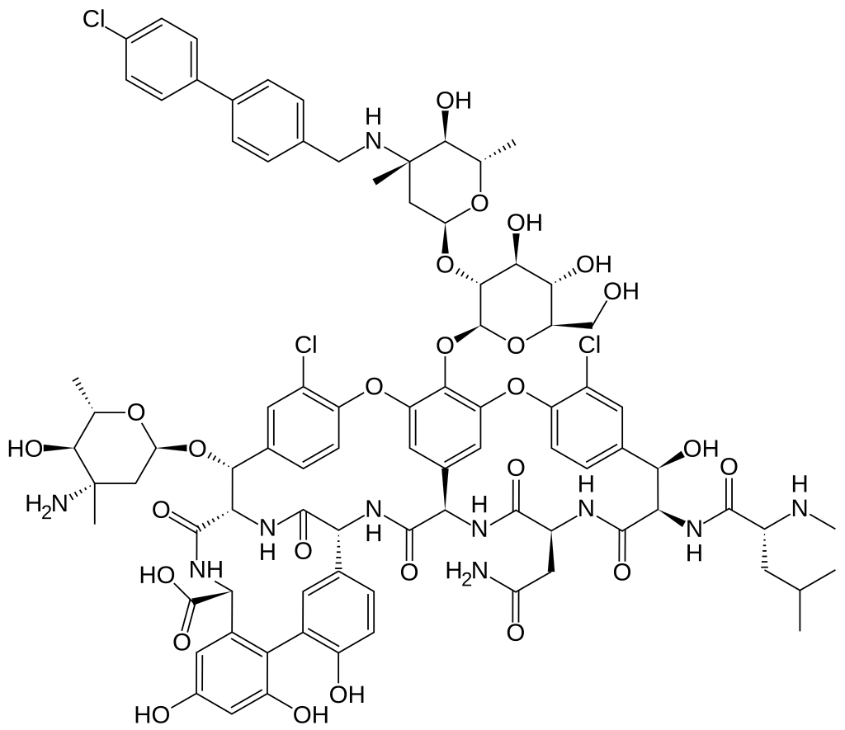
Glycopeptide Mechanism
Vancomycin
Dalbavancin
Oritavancin

Slide 15
Guideline Glycopeptide
Vancomycin (IV/PO)
  Gram positive coverage only!
    Includes MRSA
  Oral only appropriate for Clostridium difficile
Dosing Considerations
  Dosed mg/kg basis
  Requires renal dose adjustments
    Accumulate w/ impaired clearance → ↑ADRs
  AUC + Trough level monitoring
    For therapy safety & efficacy
Highlight Adverse Effects
    AUC > 600, Tr > 20 mcg/ml → AKI (usually ATN)
    Hypersensitivity = Infusion Reaction (“Red Man Syndrome”)
      Can be managed/prevented!
        Slow infusion rate
        Medicate (antihistamine, steroid)

Slide 16
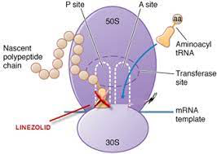
Guideline Oxazolidinone
Linezolid (IV/PO)
  Gram positive coverage only!
    Includes MRSA and VRE
      Only oral option that robustly covers
      most strains of MRSA (vs CA-MRSA)
  Bioavailability ~100% (dosing 1:1)
Highlight Adverse Effects
    Usually rare – most ADRs associated with therapy > 14 days
      Myelosuppression, Neurotoxicity
    Serotonin syndrome
      Exercise caution when co-prescribed with agents that increase serotonin (mostly mental health meds)
        Contraindicated if received MAOI (a specific antidepressant class) within 14 days

Slide 17
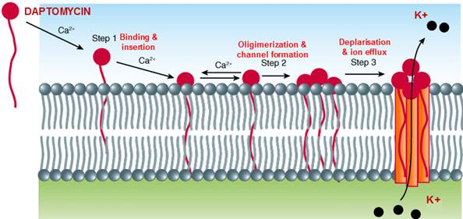
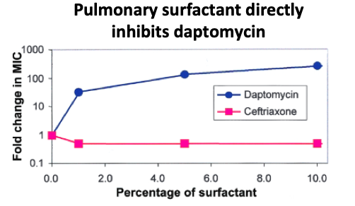
Guideline Lipopeptide
Daptomycin (IV only)
  Gram positive coverage only!
    Includes MRSA and VRE
Dosing Considerations
  Requires renal adjustment
  Dosed mg/kg basis
Highlight Adverse Effects
  Myopathy → Rhabdomyolysis (w/ statin use)
    Hold statins while on daptomycin therapy
  Eosinophilic pneumonia (rare)
    Potentially pulmonary surfactant action related?

Slide 18
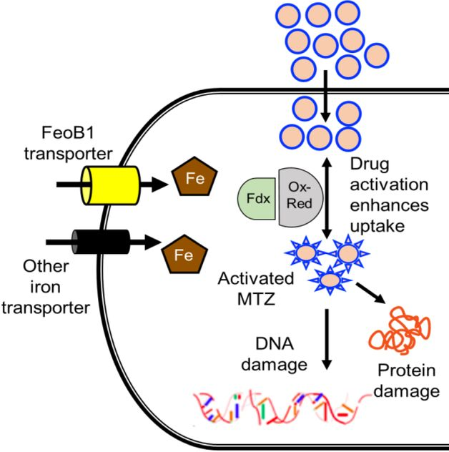
Metronidazole
Metronidazole (IV, PO)
  Highlight Adverse Effects
    Headache, N/V/D (esp with
    alcohol intake), metallic taste
  Drug Information Pearls
    Anaerobic coverage only!
    Oral bioavailability ~100%
    Dosed TID to QID
    Lots of drug interactions –
    kinetic inhibitor (usually → higher exposure)
Metronidazole

Slide 19
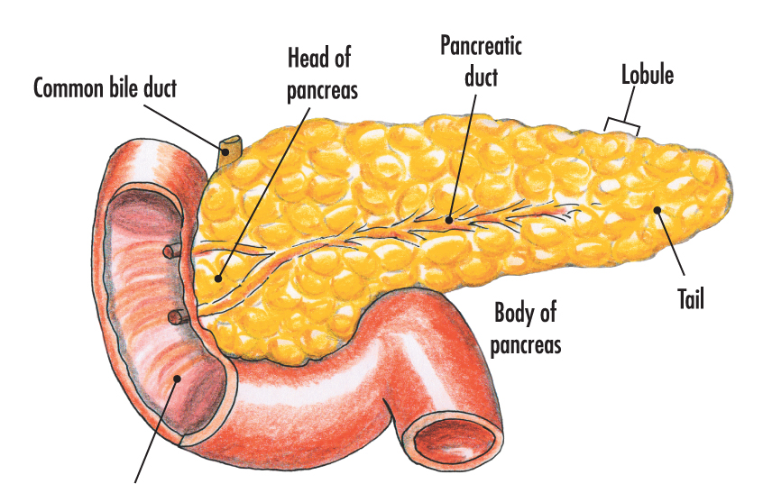
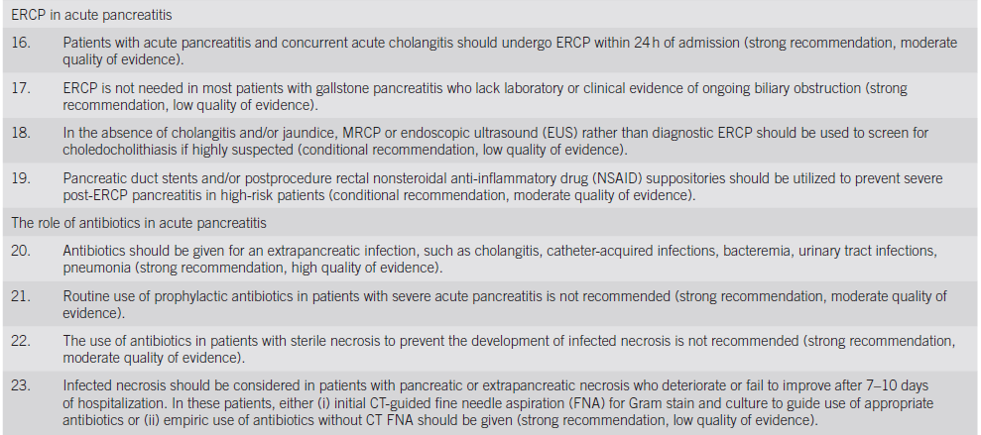
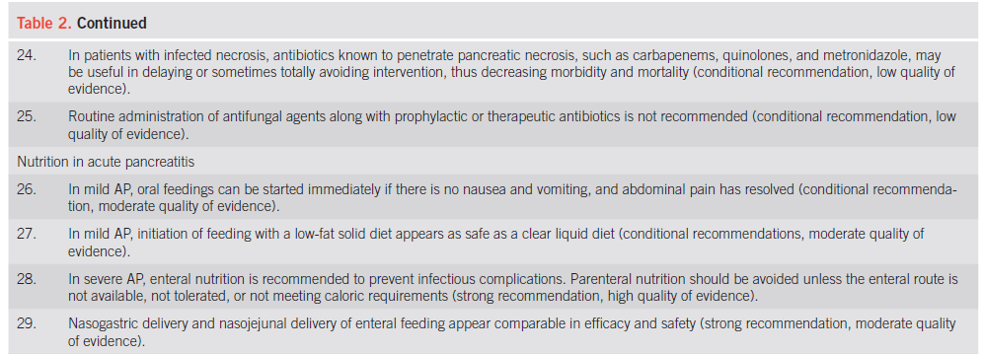
Pancreatitis
ACG 2013: Acute Pancreatitis Guidelines.

Slide 20
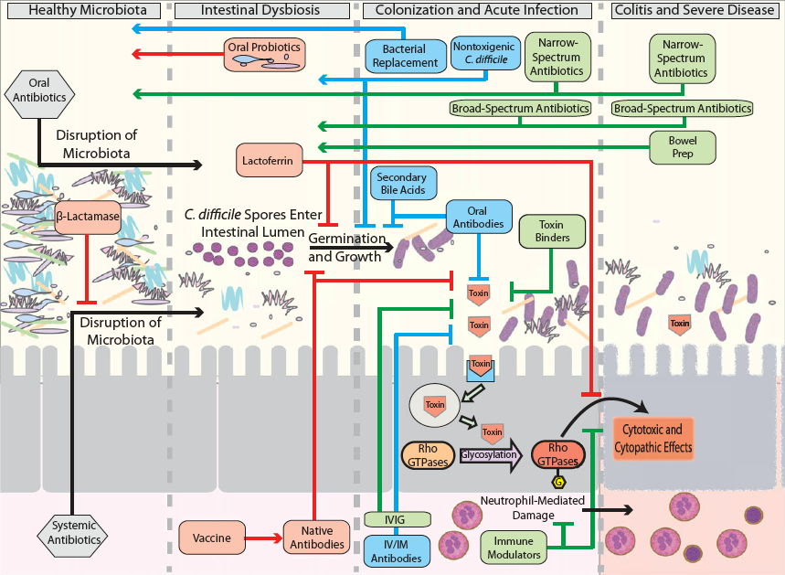
Colitis

Slide 21
Clostridium difficile
Initial episode
  1st Line: Fidaxomicin 200mg PO BID x 10 days
  Alternative: Vancomycin 125mg PO QID x 10 days
First recurrence
  Taper options
    Fidaxomicin x 20 days, vancomycin x 2-8 weeks
  Bezlotoxumab
    For pts at risk for recurrence
      Exs. >65YOA, immunocompromised, severe presentation
    Given in addition to standard of care
Subsequent recurrences
  New agent taper (vancomycin → rifaximin x 20 days)
  Fecal microbiota transplant

Slide 22

Clostridium difficile
Fulminant Episode
  Criteria = hypotension, shock, ileus, megacolon
    WBC > 15,000; SrCr > 1.5mg/dl
  Vancomycin 500mg PO QID +
  Metronidazole 500mg IV q8hours
    If ileus, consider adding rectal vancomycin

Slide 23
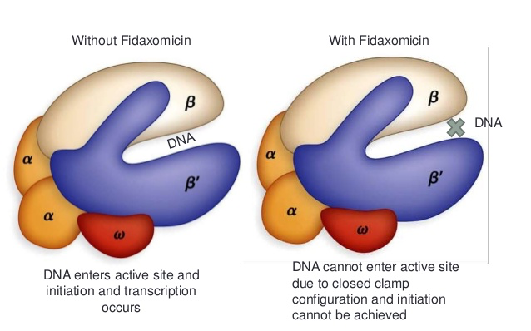
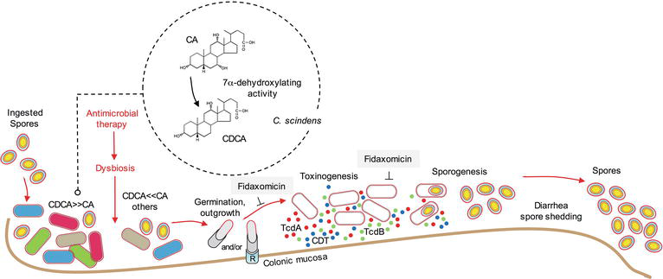
Fidaxomicin Mechanism
Notes:
Polymerase inhibition

Slide 24
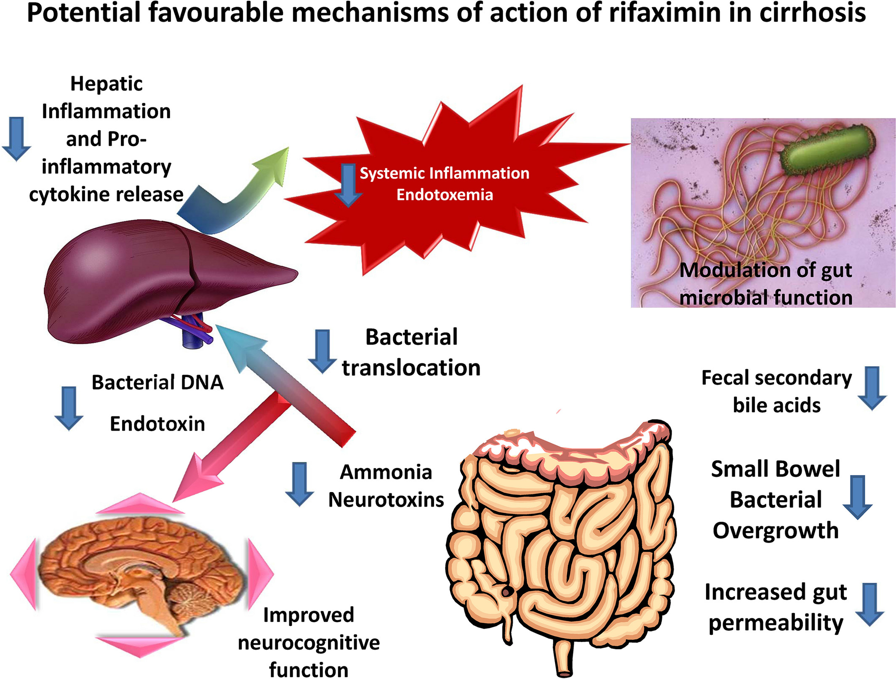
Rifaximin Mechanism

Slide 25
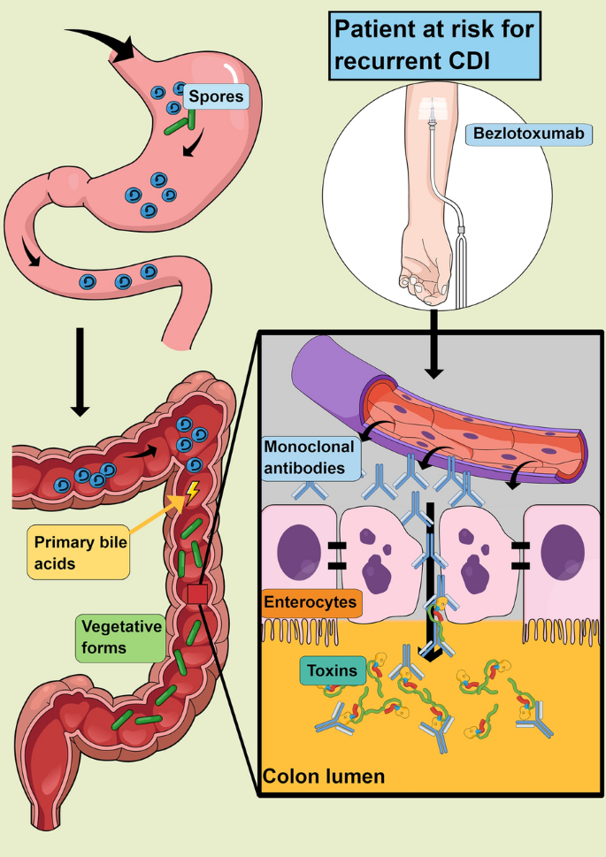
Bezlotoxumab Mechanism
Notes:
Polymerase inhibition

Slide 26
Fidaxomicin/Rifaximin
Fidaxomicin
  Technically = macrolide
    Cardiovascular adversities (ex. QTc ↑), N/V/D
      Fidaxomicin doesn’t carry same CV risk warnings
        In fact, overall very well tolerated!
    Used for C. diff only (exclusive gram-positive coverage)
Rifaximin
  Fairly benign…ADRs all confounded by indications being treated (ex. n/v/d, transaminitis)
  Do NOT confuse with rifampin

Slide 27
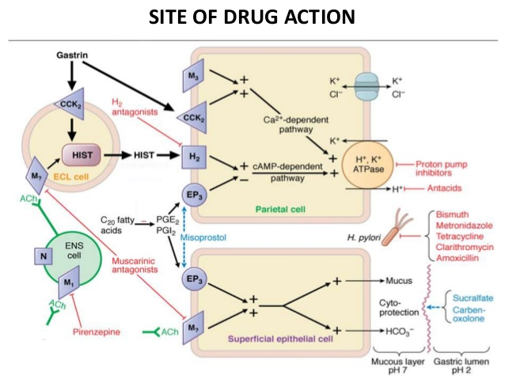
Helicobacter pylori
Antimicrobials (≥ 2) + Antisecretory (≥ 1)
  Amoxicillin (BID), clarithromycin (BID), metronidazole (TID), tetracycline (QID)
    “Tetracycline” can = Doxycycline or Minocycline (BID)
    14 day treatment duration preferred
      7-10 day regimens → failures, recurrence
    Sequential therapy = antibiotic switches ½ way + tinidazole
      Ex. PPI + amoxicillin x 5 days → PPI + clarithromycin + tinidazole x 5 days
  Proton Pump Inhibitors (BID)
    +/- Bismuth

Slide 28
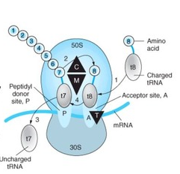
Macrolide & Tetracycline Mechanism
M = Macrolide
T = Tetracycline
Notes:
C = clindamycin, M = macrolides, T = tetracyclines

Slide 29
Guideline Macrolides/Tetracyclines
Clarithromycin
  Cardiovascular adversities (ex. ex. QTc ↑)
  Clarithromycin has significant drug interactions
Tetracycline Doxycycline, Minocycline
  Highlight Adverse Effects
    N/V/D
      Take with food (just not milk) to decrease incidence + severity
    Photosensitivity (drug-light skin reaction → ↑ sunburn/rash risk)
    Discolored dentition
      Only use in pts > 8 YOA to reduce risk of permanently staining
  Drug Information Pearls
    Gram positive coverage only!
    Oral bioavailability ~ 100%
    Avoid cations (antacids, dairy products, etc) due to chelation inhibited absorption
      Separate by 1-2 hours before AND after

Slide 30
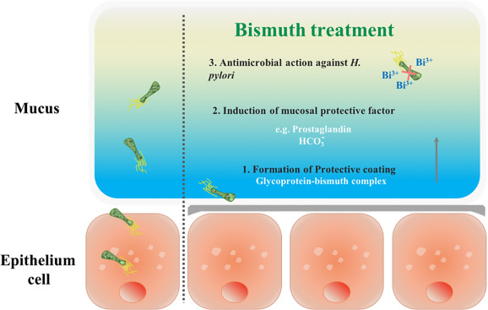
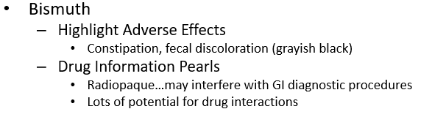
Bismuth

Slide 31
Other Bacterial Colitis/Gastritis
“Let it run its course”
  Exceptions = severe cases, immunocompromised, recurrent…
Problematic Pathogens
  Campylobacter
    Drug of Choice = Azithromycin…fluoroquinolone
  E. Coli
    Many options…sometimes ESBL-producing → tailor coverage
  Salmonella
    Drug of Choice = Ceftriaxone
    Alternatives = Azithromycin, fluroquinolone
  Shigella
    Drugs of Choice = Azithromycin, fluoroquinolone

Slide 32
Supportive Care
Don’t forget:
  Analgesics
    Appropriate for the 1) pain level 2) indication 3) patient
      Acetaminophen for mild pain…opioids for severe pain
      Avoiding NSAIDs in H. pylori
      Avoiding NSAIDs in CKD
  Antiemetics
    Ex. Ondansetron, promethazine…
    Take advantage of alternate routes (IV, RTL, TOP)
  Antispasmodics
    Ex. Dicyclomine, hyoscyamine
      MAY be helpful…literature/EBM lacking
  Antidiarrheals
    Bismuth…
    Ex. Loperamide (OTC), diphenoxylate/atropine (RX)
      NOT for invasive infections!

Slide 33
Highlight Pharmacotherapy Resources
2013 American College of Gastroenterology Management of Acute Pancreatitis Guidelines
Infectious Diseases Society of America
  Guidelines by organ and sometimes by organism
Medication Databases
  Lexi-Comp, Micromedex
Therapy QuickGuide
  UpToDate

Slide 34
Gastrointestinal Infections
PAS 523
July 2025
Robert Wood, PharmD, BCCCP, VHA-CM
Adjunct Professor, Milligan College, Physician Assistant Studies Program
Acute Care Clinical Pharmacist Practitioner, James H. Quillen VAMC
Robert.Wood5@va.gov

Slide 35
Test Yourself
PT is a 64 YOM with a PMH = alcoholic cirrhosis, arthritis, COPD, and seasonal allergies who is suspected to have community-acquired peritonitis. He is allergic to fluoroquinolones (angioedema). He is currently stable and only mildly symptomatic. You admit him to a medical floor and appropriately prescribe him:
  Ertapenem
  Cefepime
  Moxifloxacin
  Vancomycin
Notes:
A – ertapenem is the best option here…caution to the wise → another carbapenem would not be. Why? Because the expanded coverage is not warranted in a CA infection.
B – incorrect for two reasons: 1) cefepime should be combined with metronidazole as it lacks anaerobic coverage 2) pseudomonas coverage is only potentially needed in severe CA infections and warranted in HA infections…
C – moxifloxacin is a textbook regimen (but I hardly see it clinically being used)… BUT the patient is allergic ☹
D – vancomycin is also incorrect for 2 reasons: 1) it should only be prescribed for MRSA (so you would have to have a culture or it would be IN ADDITION to another agent that covers gram negative and anaerobes 2) it is for HA infections

Slide 36
Test Yourself
RP is an unfortunate 27 YOM who contracted C. diff on his clinical rotation due to poor hand hygiene. While he feels that this is severe, you deem that he is suffering from an initial, non-severe case. Select any/all optimal regimen(s) for PT.
  Vancomycin IV x 10 days
  Metronidazole PO x 10 days
  Fidaxomicin PO x 10 days
  Bezlotoxumab
  Fecal microbiota transplant
Notes:
C only
A – vancomycin is IV! Only PO is effective for C diff AND PO is only effective for C diff.
B – metronidazole not the best. While it used to be first line, it is now deprioritized due to less efficacy. Metronidazole is an alternative but you have a better choice. Furthermore, with the alcohol side effects and the number of times/day it must be given…in a 27 YOM, I MIGHT avoid for those reasons also…
D – not until at least 1st recurrence…and its ADJUNCTIVE…and it’s expensive… and, and, and ☺
E – if you selected E, you are twisted…J/K – seriously though, transplant is reserved for 2nd RECURRENCE (not 2nd time!)…and even then some would prefer to just do another ABX so long as the recurrences weren’t too close together…

Slide 37
Test Yourself
Select the best regimen below to treat a H. pylori infection.
  (Amoxicillin + Clindamycin + PPI) x 7 days
  (Amoxicillin + Clarithromycin + PPI) x 14 days
  (Metronidazole + Tetracycline + Bismuth) x 10 days
  (Metronidazole + Tinidazole + Bismuth + PPI) x 14 days
Notes:
B – remember: combine two CORE antibiotics with activity against H. pylori AND include a PPI (+ bismuth is a bonus and useful for difficult cases)
A – don’t confuse clindamycin and clarithromycin! The 7 day duration should also be a dead giveaway that this is a “less than” regimen
C – Add a PPI and you’ll have yourself a golden regimen…the focus of the lecture is on antibiotics since this is the ID module…but the PPI (antisecretory agent) is crucial to help with ulceration healing!
D – Tinidazole should be used at the tail end of sequential therapy. It is not evidenced based to use as a replacement for one of the CORE antibiotics (amoxicillin, clarithromycin, metronidazole, tetracycline)

Slide 38
Test Yourself
FP is a 25 YOF college student who plays tennis for ETSU. She has a historical allergy to PCN (GI upset) and takes no medications (although she has a PMH = congential QTc prolongation). She religiously drinks protein shakes fortified with vitamins and minerals “to stay nourished and fit.” She loves to bar hop with her friends on the weekend – “I diet to drink.” Assuming that all the antibiotic regimens below are equally efficacious for her infection, which would you choose and why?
  Amoxicillin/clavulanate
  Cefuroxime + Metronidazole
  Moxifloxacin
  Ertapenem
Notes:
*First off, in real practice, patients can be super simple to completely complex…and sometimes you find yourself trying to pick between two evils. In this question, there are some better answers and better reasoning but once narrowed down, it isn’t so straight forward.
**I would NEVER give you a test question like this – 1) you would freak out! 2) it wouldn’t be fair…although it might be real world ;)
A – If I had to say one choice was best, this would be it for me. While she does have a PCN allergy, as long as its not severe, I’m ok “challenging“ it. Moreover, many PCN allergies, especially when they are “historical,” aren’t reliable. Sometimes its because the person is elderly and back then the formulation was more crude. Other times, its because the allergy/reaction occurred when the patient was very young – a new immune system is hypersensitive in many ways… Lastly, if we challenge it and she tolerates just fine, you’ve just opened up a great class of drugs for her to be prescribed (affordable, lots of options within therapeutics, etc). She can also just take with food and it should help significantly!
B – This is probably “incorrect.” Two drug combination where one of those meds is metronidazole…that’s A LOT of meds to remember to take. Moreover, she likes to bar hop for which she would either have to give up or suffer the consequences of the disulfuram reaction (=profuse vomiting) with metronidazole + EtOH.
C – WRONG…She has congenital QTc prolongation which FQ could worsen…you might argue that a short course in someone who doesn’t require medication won’t be a problem…or in a critically ill patient we would just monitor, particularly if the FQ is the best ABX for the job…BUT she’s 25 and healthy. Moreover, fluoroquinolone-induced tendinopathies are no joke…and she plays tennis… For these reasons, I’d avoid FQ. And if she develops a life-threatening arrhythmia because you prescribe a FQ or she ruptures a tendon and her tennis days are over…well, let’s just say that I wouldn’t want to be your defense attorney. Oh! And she drinks those nasty shakes which are just waiting to bind up that expensive FQ with their mineral cations…the prosecution rests.
D – If my teaching experience serves me right, you probably selected ertapenem…and its probably the best exam answer. Just keep in mind that it is only available IV (so she’s either got to maintain IV access, be hospitalized etc for her entire treatment course or she’s going to have to eventually take something else)…and when resistance develops, the carbapenems are one of the only classes we have in reserve that preserve activity.
***Consider this → did you reason your choice out similarly? Did you consider all of the drawbacks to a particular regimen not just one and move on? I sincerely want you to be the best medication-informed PAs graduating in the country! One day you might be taking care of me and/or my family…but less selfishly, I hope you develop the best skills in HOW to use medications to help all your patients…not just the WHAT (=facts) about the medications.

